Slide 1
Claim 4 Smarter Balanced Sample Items Grade 7
Modeling and Data Analysis
Questions courtesy of the Smarter Balanced Assessment Consortium Item Specifications – Version 3.0
Slideshow organized by SMc Curriculum – www.ccssmathactivities.com

Slide 2
#1
A store is having a sale. Each customer receives either a 15% discount on purchases under $100 or a 20% discount on purchases of $100 or more. Kelly is purchasing some clothes for $96.60 before the discount. She decides to buy the fewest packs of gum that will increase her purchase to over $100. The price of each pack of gum is $0.79. After the discount, how much less will Kelly pay buying the clothes and the gum instead of buying only the clothes? (Assume there is no sales tax to consider.)
A. $1.05 C. $3.69
B. $1.67 D. $3.87

Slide 3
#1 Answer
Rubric:
(1 point) The student selects the correct amount.
Answer: B

Slide 4
#2
Elias is a produce manager at a grocery store. He buys fresh vegetables from local farmers each week. Based on previous sales, he has identified the following ideal ratios (in pounds) to keep in stock for certain vegetables.
The ratio of
tomatoes to onions is 3:2.
onions to peppers is 2:1.
peppers to cucumbers is 2:5.
This table shows the amount, in pounds, of each vegetable a local farmer has available to sell to Elias.
Elias buys all 50 pounds of the farmer’s cucumbers. He then buys the remaining vegetables according to the ideal ratios shown above. Enter the amount of peppers, in pounds, Elias buys in the first the response box. Enter the amount of tomatoes, in pounds, Elias buys in the second response box
Vegetable | Amount (lbs)
Cucumbers | 50
Onions | 55
Peppers | 30
Tomatoes | 85

Slide 5
#2 Answer
Rubric:
(2 points) The student correctly enters the amounts for both peppers and tomatoes.
(1 point) The student enters the correct amount for one vegetable, but not both.
Answer: 20, 60

Slide 6
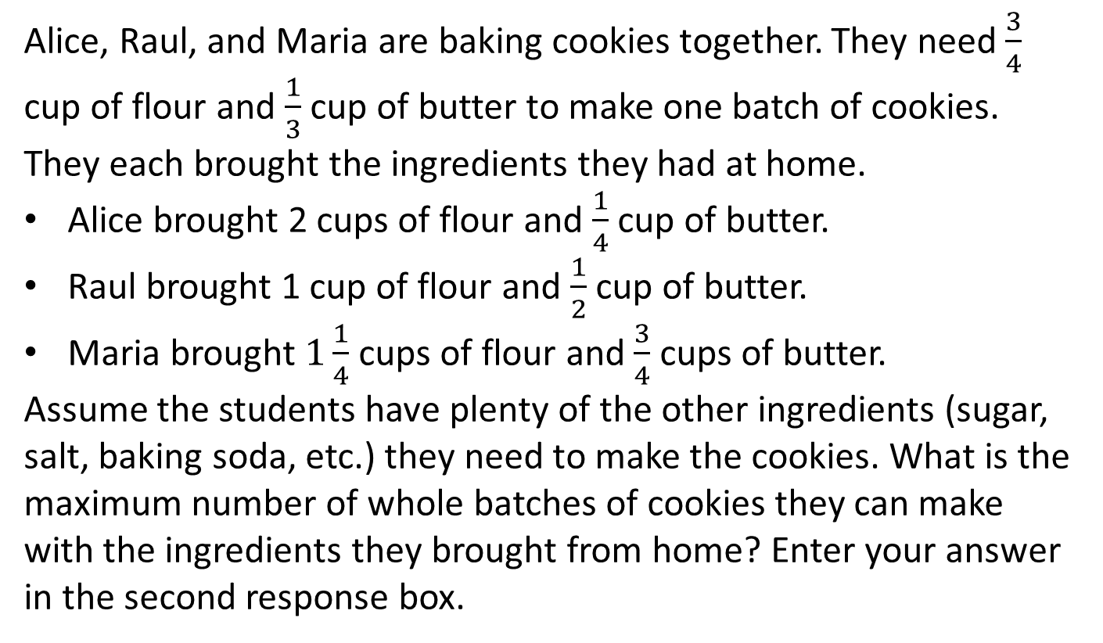
#3
Alice, Raul, and Maria are baking cookies together. They need $\frac{3}{4}$ cup of flour and $\frac{1}{3}$ cup of butter to make one batch of cookies. They each brought the ingredients they had at home.
Alice brought 2 cups of flour and $\frac{1}{4}$ cup of butter.
Raul brought 1 cup of flour and $\frac{1}{2}$ cup of butter.
Maria brought $1\frac{1}{4}$ cups of flour and $\frac{3}{4}$ cups of butter.
Assume the students have plenty of the other ingredients (sugar, salt, baking soda, etc.) they need to make the cookies. What is the maximum number of whole batches of cookies they can make with the ingredients they brought from home? Enter your answer in the second response box.

Slide 7
#3 Answer
Rubric:
(1 point) Student selects the correct number of whole batches.
Answer: 4

Slide 8
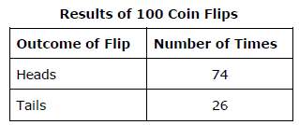
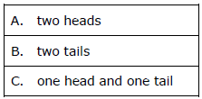
#4
Ramos flipped a coin 100 times and records the results in a box.
Part A
Select an assumption about the outcome of a single flip of this coin—heads and tails are equally likely; heads are 3 times as likely as tails.
Part B
Based on your assumption, which would be the most likely outcome for the next 2 flips?

Slide 9
#4 Answer
Rubric:
(1 point) Student makes correct choice based on the assumption they choose.
Answer: C for the first assumption, A for the second assumption.

Slide 10
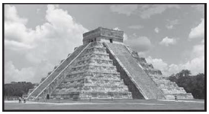
#5
Chichén Itzá was a Mayan city in what is now Mexico. The picture shows El Castillo, also known as the pyramid of Kukulcán, which is located in the ruins of Chichén Itzá.
The pyramid is approximately 30 meters tall, and there are 91 steps leading up to a temple at the top. What additional information do you need to know to estimate the height about the ground, in meters, of the 50th step? Select all that apply.
Each of the steps has approximately the same height.
The base of the pyramid is about 55 meters wide.
The height of the temple is about 6 meters.
The base of the pyramid is a square.

Slide 11
#5 Answer
Rubric:
(1 point) The student selects the correct options.
Answer: A and C

Slide 12
#6
Megan has $2500. She spends money on the following:
$800 on rent
$400 on food
$200 on utility services
$250 on loan payments
$x on other expenses
Let y represent the amount of money in dollars Megan has left. Write an equation that represents the relationship between the amount of money Megan spends on other expenses and the amount of money Megan has left.

Slide 13
#6 Answer
Rubric:
(1 point) The student computes Megan’s spending and represents the remaining money with an equation.
Answer: y = 850 – x, or equivalent

