Slide 1
Grade 3
Mathematics Application Problems

Slide 2
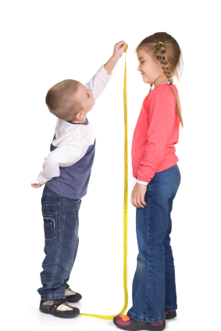
There are 83 girls and 76 boys in the third grade. How many total students are in the third grade?

Slide 3
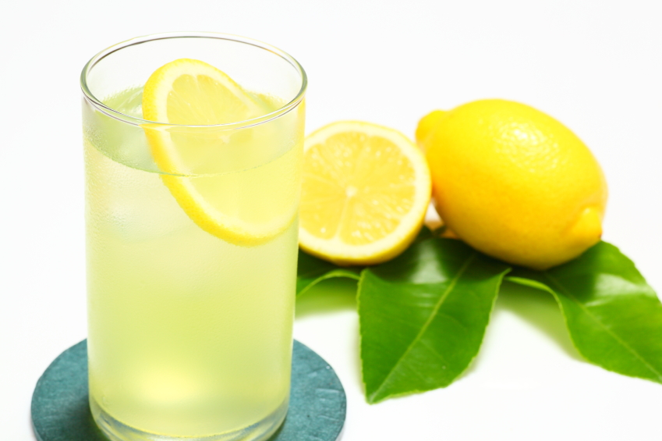
Jordan uses 3 lemons to make 1 pitcher of lemonade. He makes 4 pitchers. How many lemons does he use altogether? Use the RDW process to show your solution.

Slide 4
Robbie sees that a carton of eggs shows an array with 2 rows of 6 eggs. What is the total number of eggs in the carton? Use the RDW process to show your solution.

Slide 5
The student council holds a meeting in Mr. Chang’s classroom. They arrange the chairs in 3 rows of 5. How many chairs are used in all? Use the RDW process.

Slide 6
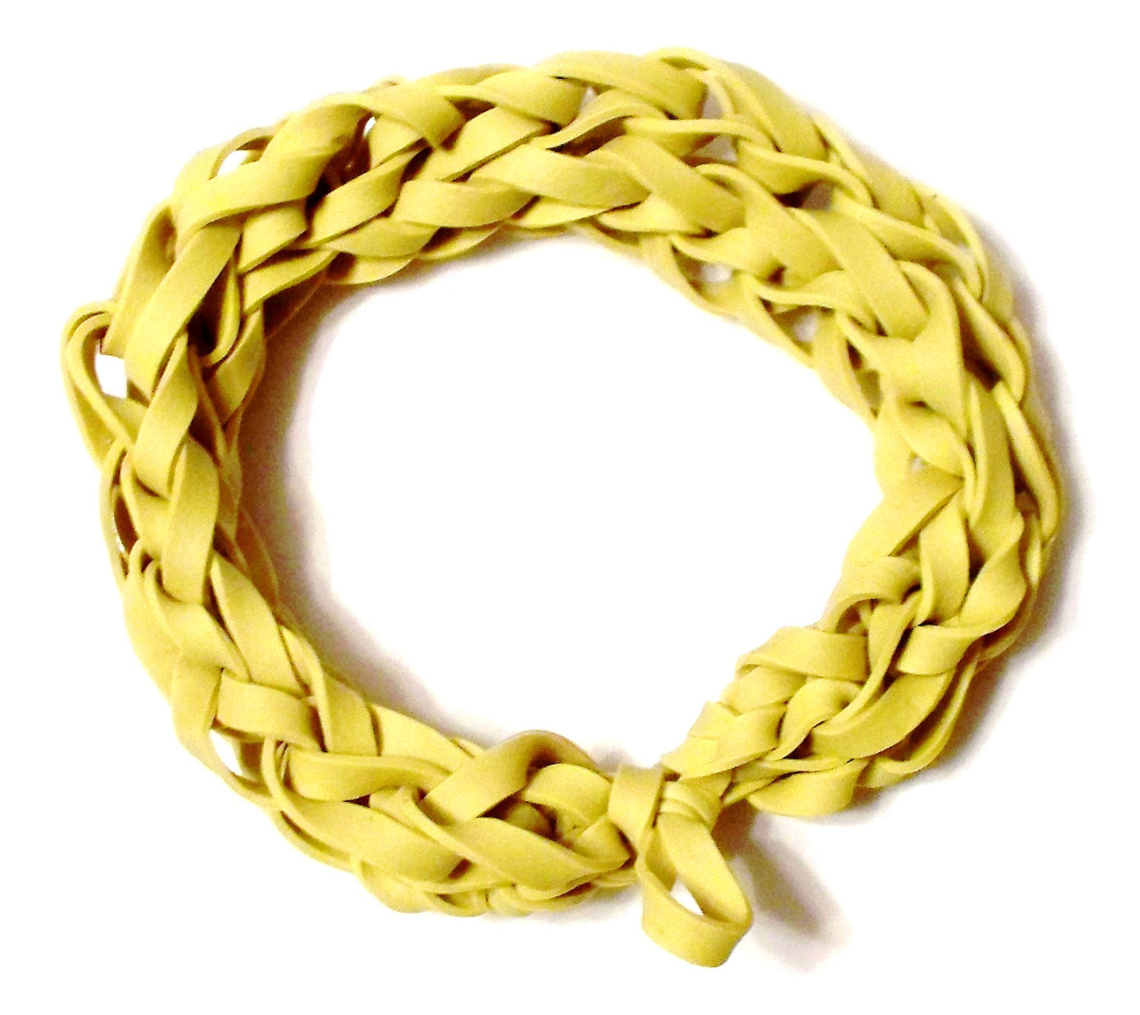
Stacey has 18 bracelets. After she organizes the bracelets by color she has 3 equal groups. How many bracelets are in each group?

Slide 7
Twenty children play a game. There are 5 children on each team. How many teams play the game? Write a division sentence to represent the problem.

Slide 8
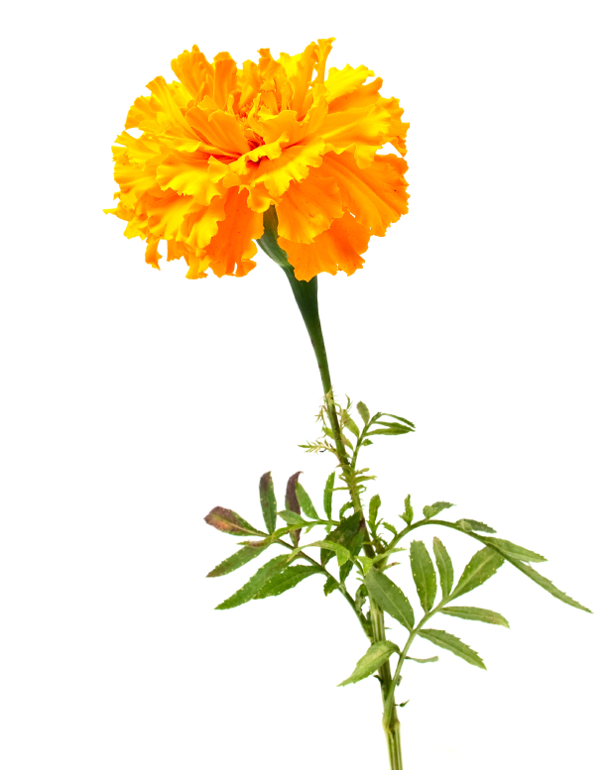
Anna picks 24 flowers. She makes equal bundles of flowers and gives 1 bundle to each of her 7 friends. She keeps a bundle for herself too. How many flowers does Anna put in each bundle?

Slide 9
Children sit in 2 rows of 9 on the carpet for math time. Erin says, “We make 2 equal groups.” Vittesh says, “We make 9 equal groups.” Who is correct? Explain how you know using models, numbers, and words.

Slide 10
A guitar has 6 strings. How many strings are there on 3 guitars? Write a multiplication sentence to solve.

Slide 11
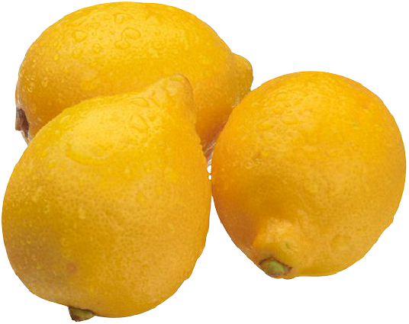
Rosie puts 2 lemon slices in each cup of iced tea. She uses a total of 8 slices. How many cups of iced tea does Rosie make?

Slide 12
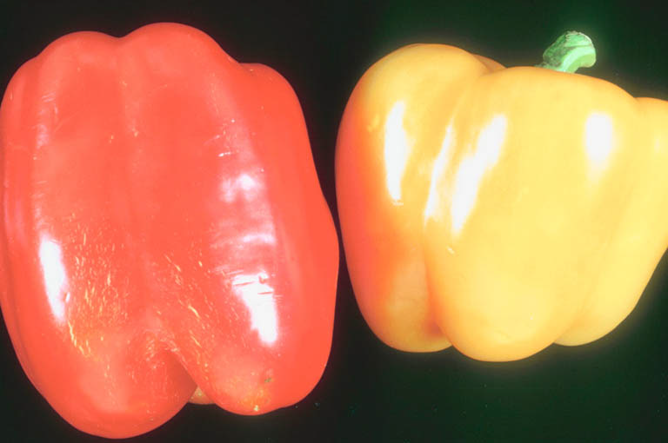
A chef arranges 4 rows of 3 red peppers on a tray. He adds 2 more rows of 3 yellow peppers. How many peppers are there altogether?

Slide 13
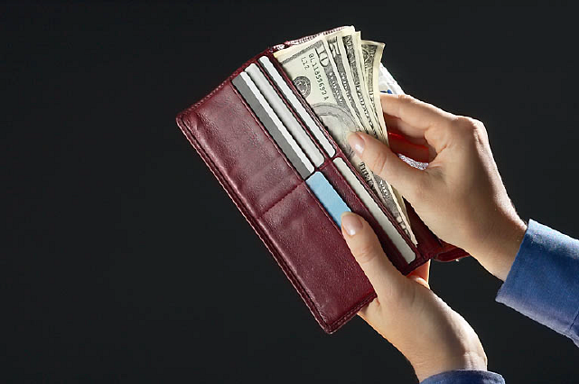
Mark spends $16 on 2 video games. Each game costs the same amount.
Find the cost of each game.

Slide 14
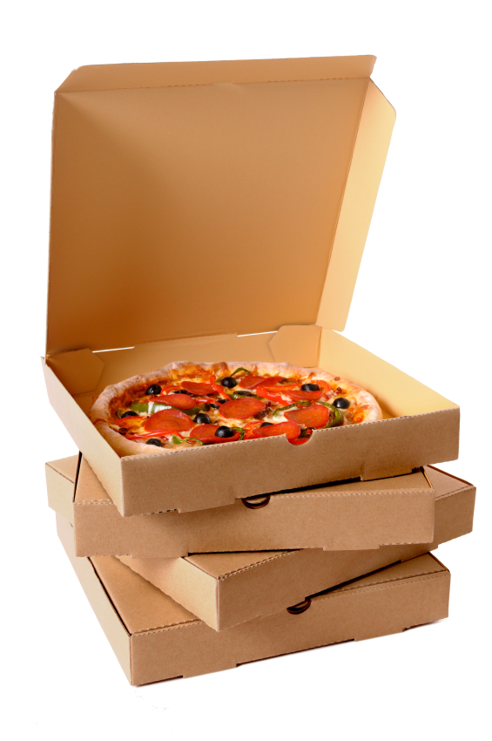
Jackie buys 21 pizzas for a party.
She places 3 pizzas on each table.
How many tables are there?

Slide 15

A cell phone is about 4 inches long. About how long are 9 cell phones laid end to end?

Slide 16
Ms. Williams draws the array below to show the class seating chart. She sees the students in 4 rows of 7 when she teaches at Board 1. Use the commutative property to show how Ms. Williams sees the class when she teaches at Board 2.
Board 1
Board 2

Slide 17
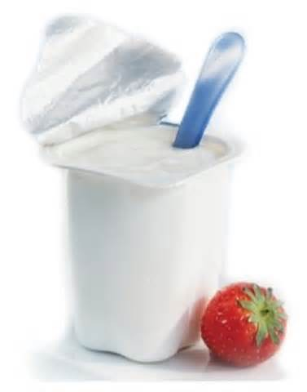
Mrs. Peacock bought 4 packs of yogurt. She had exactly enough to give each of her 24 students
1 yogurt cup. How many yogurt cups are there in 1 pack?

Slide 18
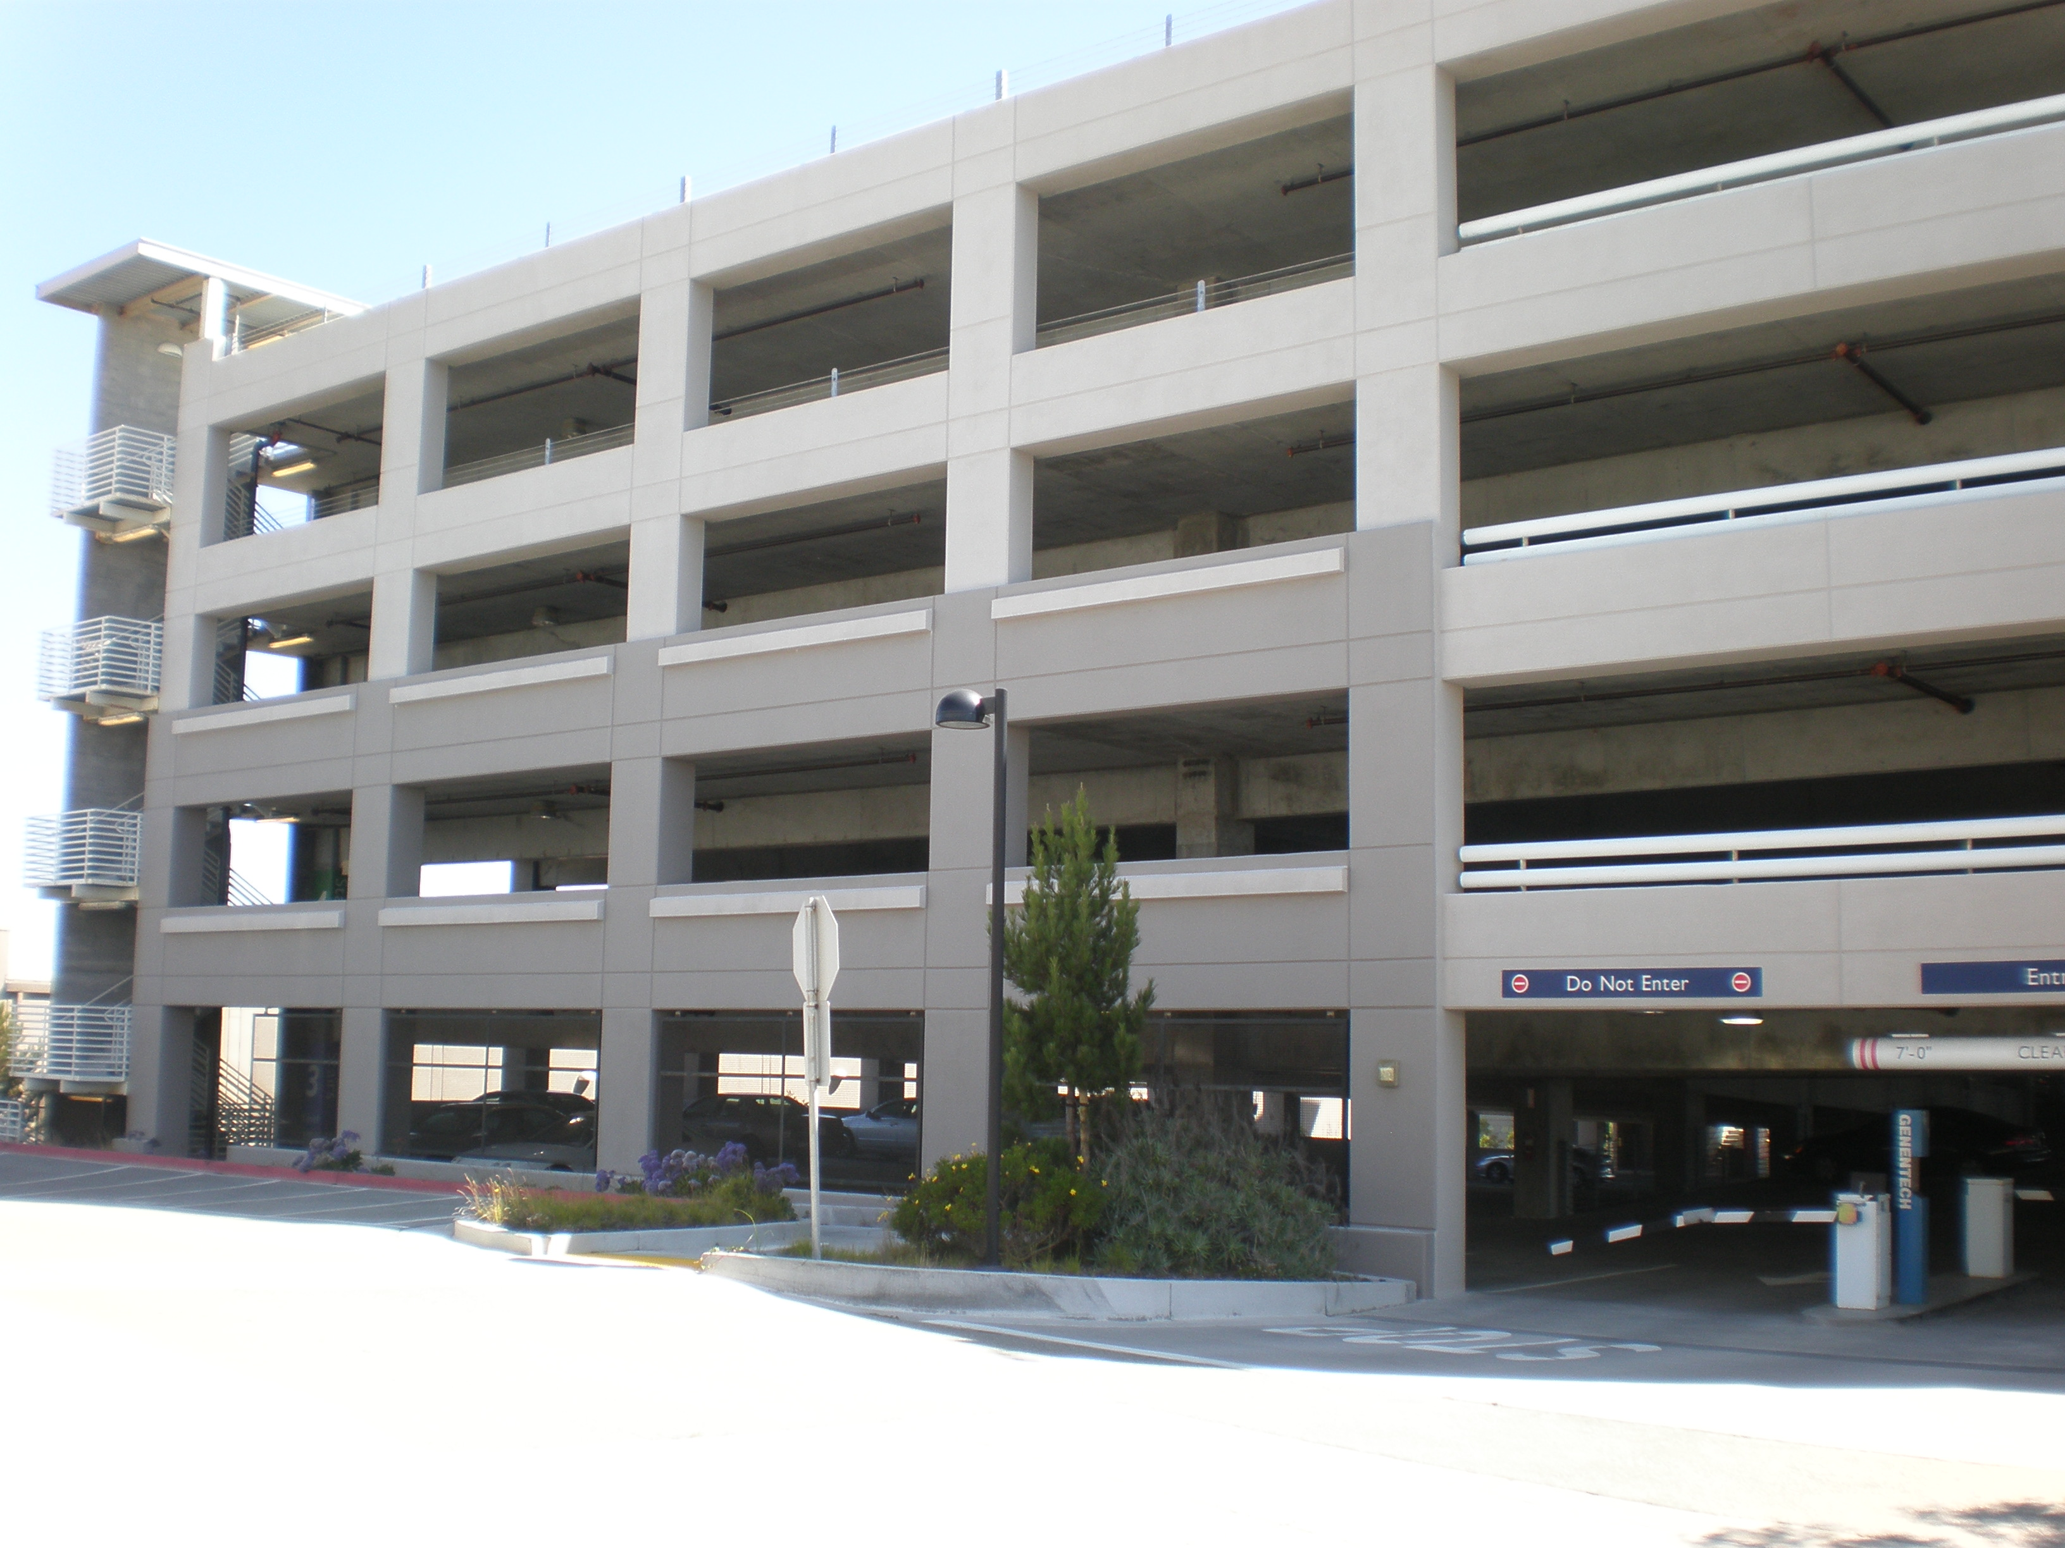
A parking structure has 10 levels. There are 3 cars parked on each level. How many cars are parked in the structure?

Slide 19
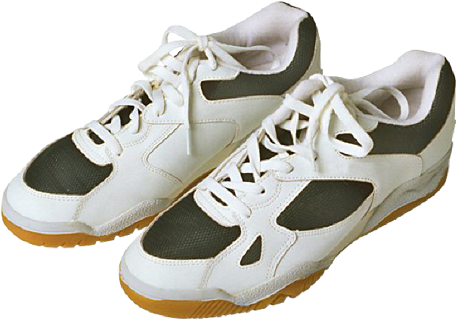
Henrietta works in a shoe store. She uses 2 shoelaces to lace each pair of shoes. She has a total of 24 laces. How many pairs of shoes can Henrietta lace?

Slide 20
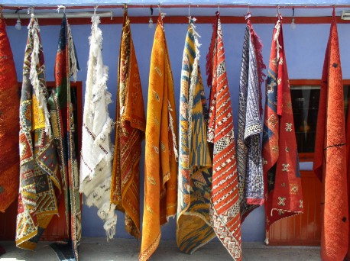
Red, orange, and blue scarves are on sale for $4 each. Nina buys 2 scarves of each color. How much does she spend altogether?

Slide 21
There are 4 boxes with 6 binders in each one. Three brothers share the binders. How many binders does each brother get?

Slide 22
Ms. Bower helps her kindergartners tie their shoes. It takes her
5 seconds to tie 1 shoe. How many seconds does it take Ms. Bower to tie 8 shoes?

Slide 23
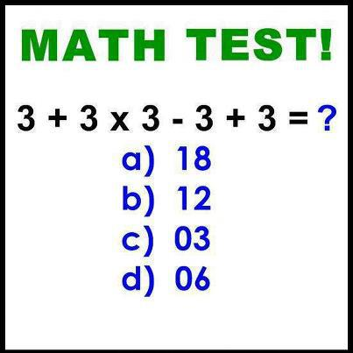
Christine has 12 math problems for homework. It takes her
5 minutes to complete each problem. How many minutes does
it take Christine to finish all 12 problems?

Slide 24
There are 12 tables in the cafeteria. Five students sit at each of the first 11 tables. Three students sit at the last table. How many students are sitting at the 12 tables in the cafeteria?

Slide 25
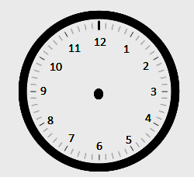
Patrick and Lilly start their chores at 5:00 p.m. The clock
and the number line show the times that Patrick and Lilly finish their chores. Who finishes first? Explain how you know. Solve the problem without drawing a number line. You might want to visualize or use your clock template, draw a tape diagram, use words, number sentences, etc.
Lilly
Patrick
5:00 p.m.
6:00 p.m.
0
60

Slide 26
Carlos gets to class at 9:08 a.m. He has to write down homework assignments and complete morning work before math begins at 9:30 a.m. How many minutes does Carlos have to complete his tasks before math begins?

Slide 27
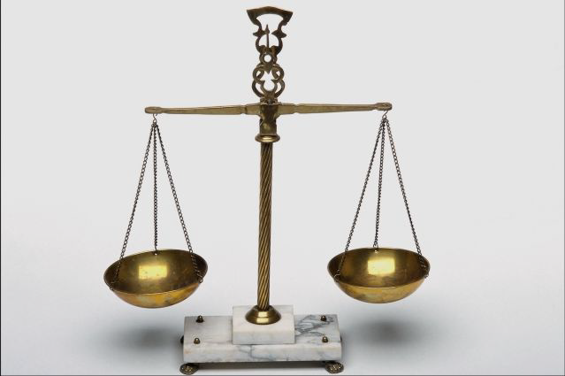
Justin put a 1-kilogram bag of flour on one side of a pan balance. How many 100-gram bags of flour does he need to put on the other pan to balance the scale?

Slide 28
Subha drinks 4 large glasses of water each day. How many large glasses of water does she drink in 7 days?

Slide 29
The school ballet recital begins at 12:17 p.m. and ends at 12:45 p.m. How many minutes long is the ballet recital?

Slide 30
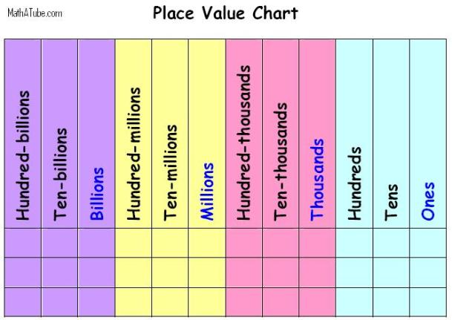
Model the following on a place value chart:
10 tens
10 hundreds
13 tens
13 hundreds
13 tens and 8 ones
13 hundreds, 8 tens and 7 ones

Slide 31
Use mental math to solve these problems. Record your strategy for solving each problem.
46 mL + 5 mL b. 39 cm + 8 cm
c. 125 g + 7 g d. 108 L + 4 L

Slide 32

Josh’s apple weighs 93 grams. His pear weighs 152 grams. What is the total weight
of the apple and the pear?

Slide 33
The doctor prescribed 175 milliliters of medicine on Monday and 256 milliliters of medicine on Tuesday.
a. Estimate how much medicine he
prescribed in both days.
b. Precisely how much medicine did he use
in both days?

Slide 34
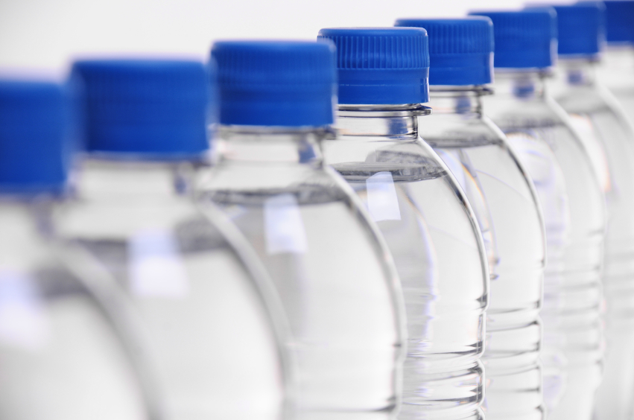
Tara brings 2 bottles of water on her hike. The first bottle has 471 milliliters of water, and the second bottle has 354 milliliters of water. How many milliliters of water does Tara bring on her hike?

Slide 35
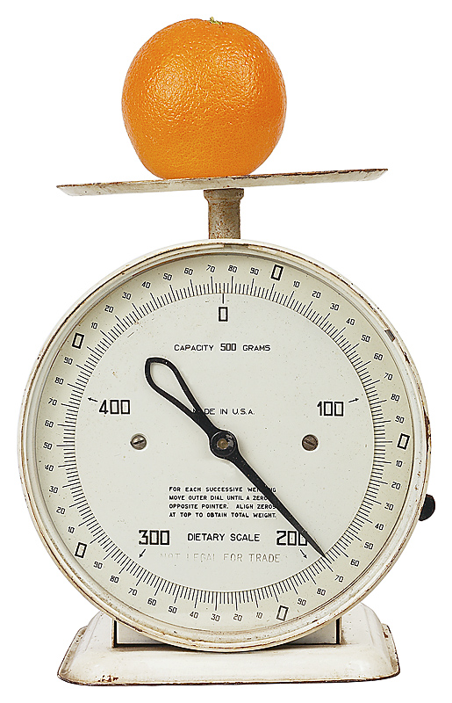
Jolene brings an apple and an orange with her to school. The weight of both pieces of fruit together is 417 grams. The apple weighs 223 grams.
What is the weight of Jolene’s orange?

Slide 36
Millie’s fish tank holds 403 liters of water. She empties out 185 liters of water to clean the tank. How many liters of water are left in the tank?
a. Estimate how many liters are left in the tank by rounding.
b. Estimate how many liters are left in the tank by rounding in a
different way.
c. How many liters of water are actually left in the tank?
d. Is your answer reasonable? Which estimate was closer to the
exact answer?

Slide 37
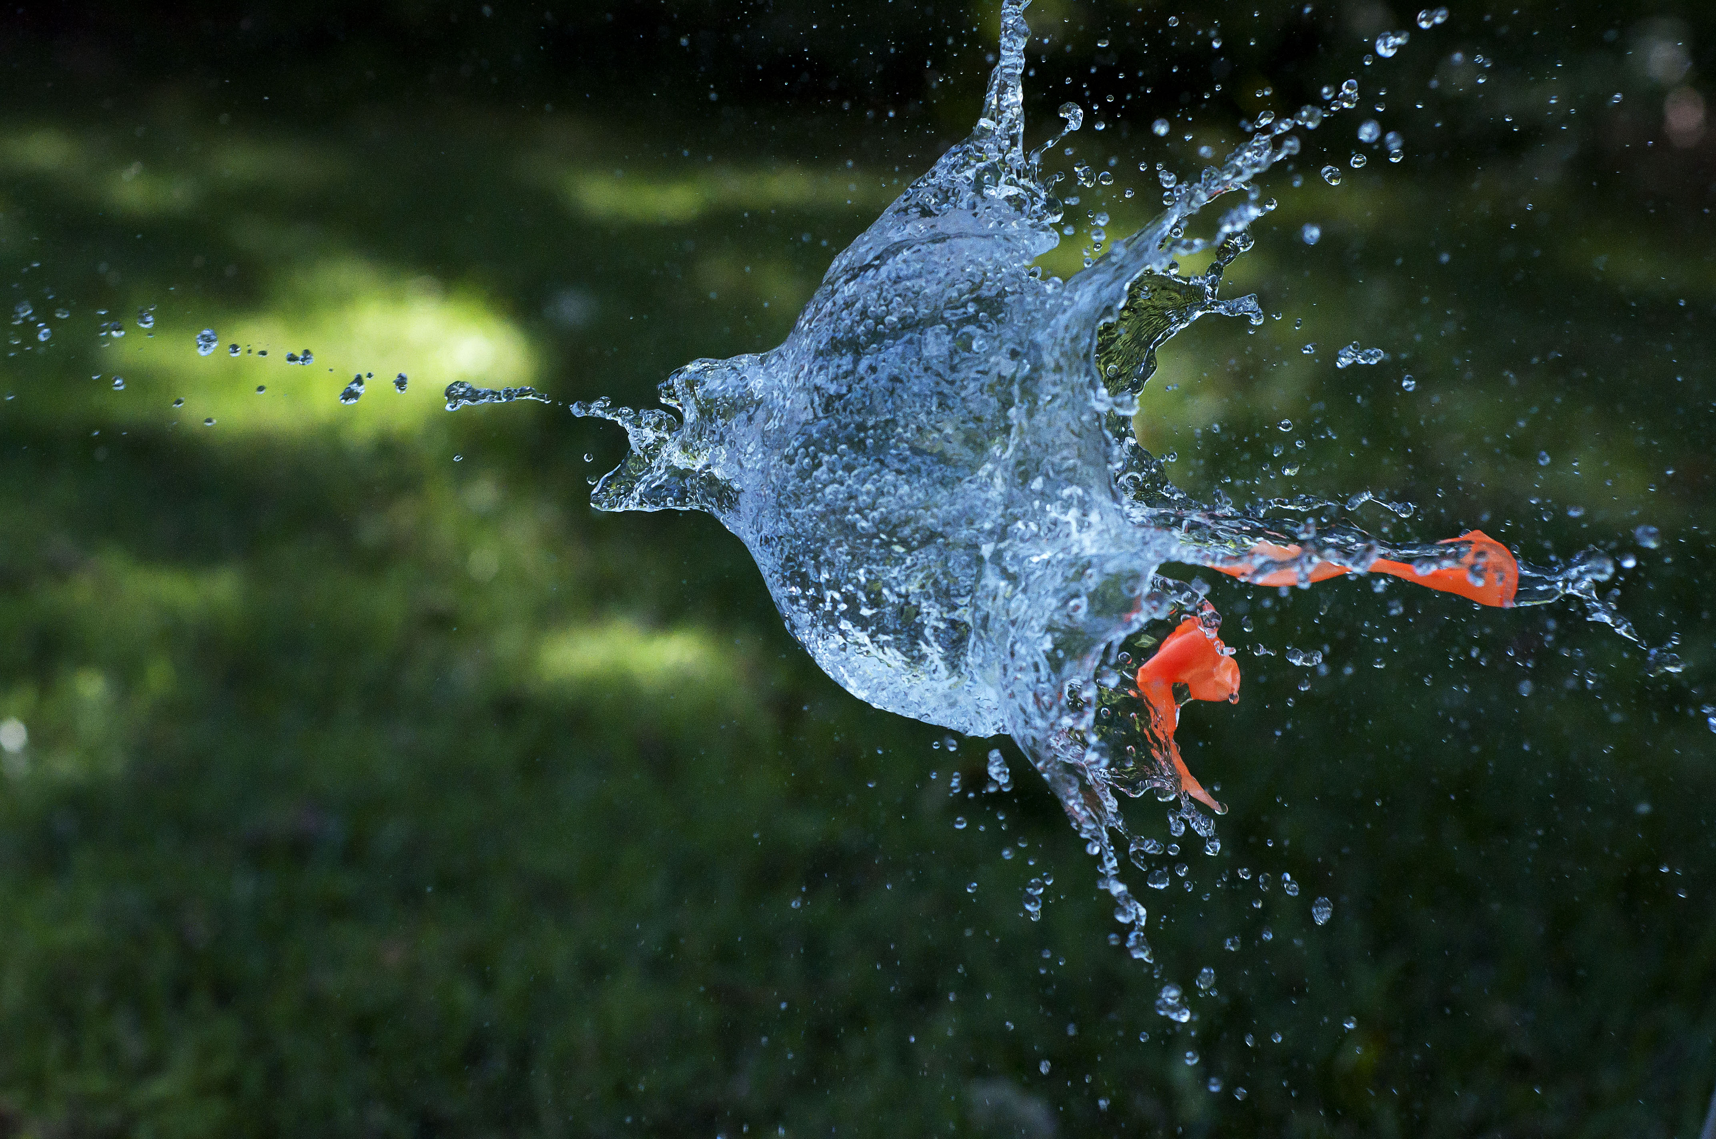
Gloria fills water balloons with 238 mL of water. How many milliliters of water are in 2 water balloons? Estimate to the nearest 10 mL and 100 mL. Which gives a closer estimate?

Slide 38
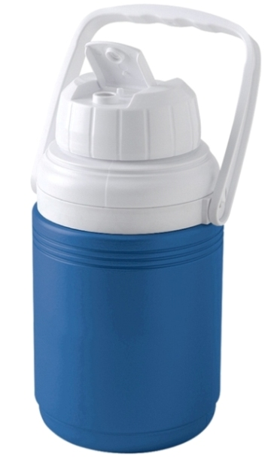
Geri brings 3 water jugs to her soccer game to share with teammates. Each jug contains 6 liters of water. How many liters of water does Geri bring?

Slide 39
Jocelyn says 7 fives has the same answer as 3 sevens + 2 sevens. Is she correct? Explain why or why not.

Slide 40
Twenty-four people line up to use the canoes at the park. Three people are assigned to each canoe. How many canoes are used?

Slide 41
Marshall puts 6 pictures on each of the 6 pages in his photo album. How many pictures does he put in the photo album in all?

Slide 42
Gracie draws 7 rows of stars. In each row, she draws 4 stars. How many stars does Gracie draw in all? Use a letter to represent the unknown and solve.

Slide 43
Mabel cuts 9 pieces of ribbon for an art project. Each piece of ribbon is 7 centimeters long. What is the total length of the pieces of ribbon that Mabel cuts?

Slide 44
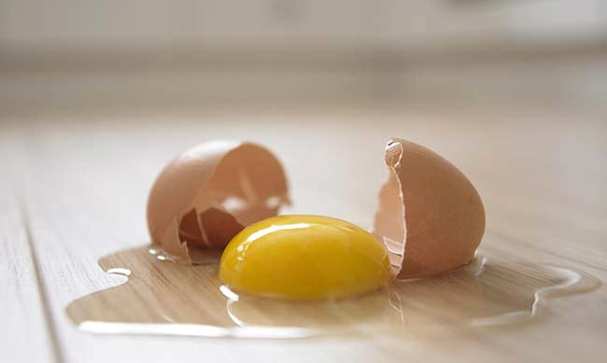
Richard has 2 cartons with 6 eggs in each. As he opens the cartons, he drops 2 eggs. How many unbroken eggs does Richard have left?

Slide 45
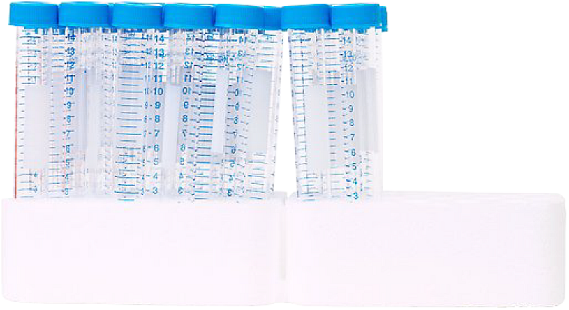
A scientist fills 5 test tubes with 9 milliliters of fresh water in each. She fills another 3 test tubes with 9 milliliters of salt water in each. How many milliliters of water does she use in all? Use the break apart and distribute strategy to solve.

Slide 46
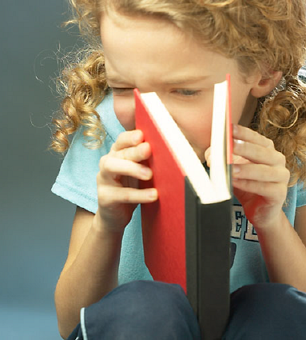
Michaela and Gilda read the same book. It takes Michaela about 8 minutes to read a chapter, and Gilda about 10 minutes. There
are 9 chapters in the book. How many fewer minutes does Michaela spend reading than Gilda?

Slide 47
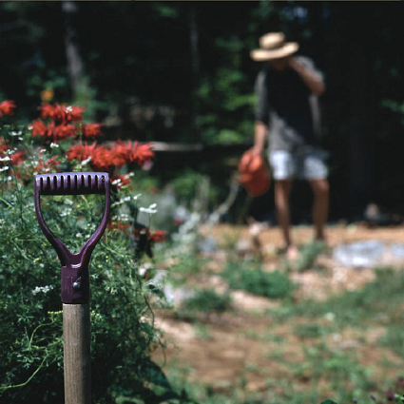
Henry’s garden has 9 rows of squash plants. Each row has 8 squash plants. There is also 1 row with 8 watermelon plants. How many squash and watermelon plants does Henry have in all?

Slide 48
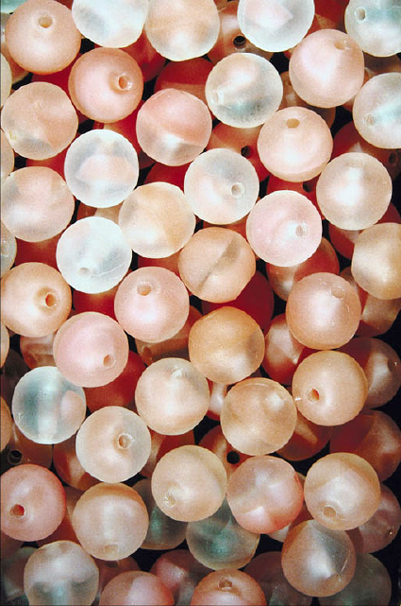
Mia has 152 beads. She uses some to make bracelets. Now there are 80 beads. If she uses
8 beads for each bracelet, how many bracelets does she make?

Slide 49
Model 3 × 4 on a place value chart. Then explain how the array can help you solve 30 × 4.

Slide 50
Eric makes a shape with 8 trapezoid pattern blocks. Brock makes the same shape using triangle pattern blocks. It takes 3 triangles to make 1 trapezoid. How many triangle pattern blocks does Brock use?

Slide 51
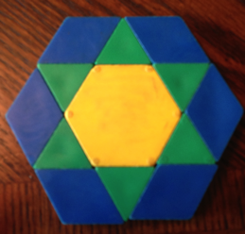
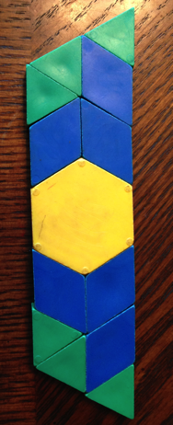
Wilma and Freddie use patterns blocks to make shapes as shown. Freddie says his shape is bigger than Wilma’s because it’s longer than hers. Is he right? Explain your answer.
Wilma’s Shape
Freddie’s Shape

Slide 52
Jace uses paper squares to create a rectangle. Clary cuts all of Jace’s squares in half to create triangles. She uses all the triangles to make a rectangle. There are 16 triangles in Clary’s rectangle. How many squares were in Jace’s shape?

Slide 53
Mara uses 15 square-centimeter tiles to make a rectangle. Ashton uses 9 square-centimeter tiles to make a rectangle.
Draw what Mara’s and Ashton’s rectangles
might look like.
b. Whose rectangle has a bigger area?
How do you know?

Slide 54
Candice uses square-centimeter tiles to find the side lengths of a rectangle as shown. She says the side lengths are 5 centimeters and 7 centimeters. Her partner, Luis uses a ruler to check Candice’s work and says that the side lengths are 5 centimeters and
6 centimeters. Who is right? How do you know?

Slide 55
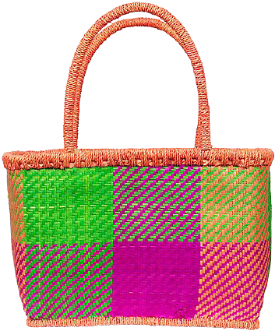
Huma has 4 bags of square-inch tiles with 6 tiles in each bag. She uses them to measure the area of a rectangle on her homework. After covering the rectangle, Huma has 4 tiles left. What is the area of the rectangle?

Slide 56
Lori wants to replace the square tiles on her wall. The square tiles are sold in boxes of 8 square tiles. Lori buys 6 boxes of tiles. Does she have enough to replace all the tiles, including the tiles under the painting? Explain your answer.
Painting

Slide 57
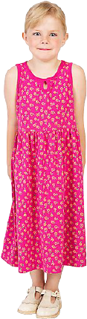
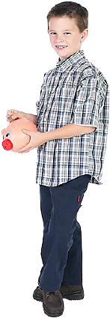
Marnie and Connor both skip-count square units to find the area of the same rectangle. Marnie counts, “3, 6, 9, 12, 15, 18, 21.” Connor counts, “7, 14, 21.” Draw what the rectangle might look like, then label the side lengths and find the area.

Slide 58
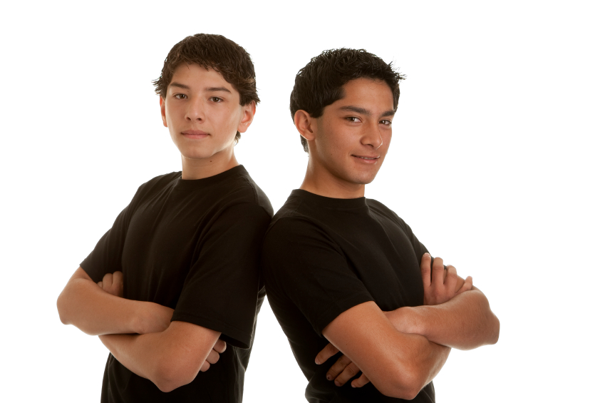
Mario plans to completely cover his 8-inch by 6-inch cardboard with square-inch tiles. He has 42 square-inch tiles. How many more square-inch tiles does Mario need to cover the cardboard without any gaps or overlap? Explain your answer

Slide 59
Sonya folds a 6 by 6 square inch piece of paper into 4 equal parts, shown below. What is the area of 1 of the parts?

Slide 60
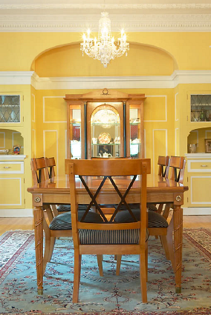
The restaurant’s banquet table measures 3 feet by 6 feet. For a large party, workers at the restaurant place 2 banquet tables side by side to create 1 long table. Find the area of the new, longer table.

Slide 61
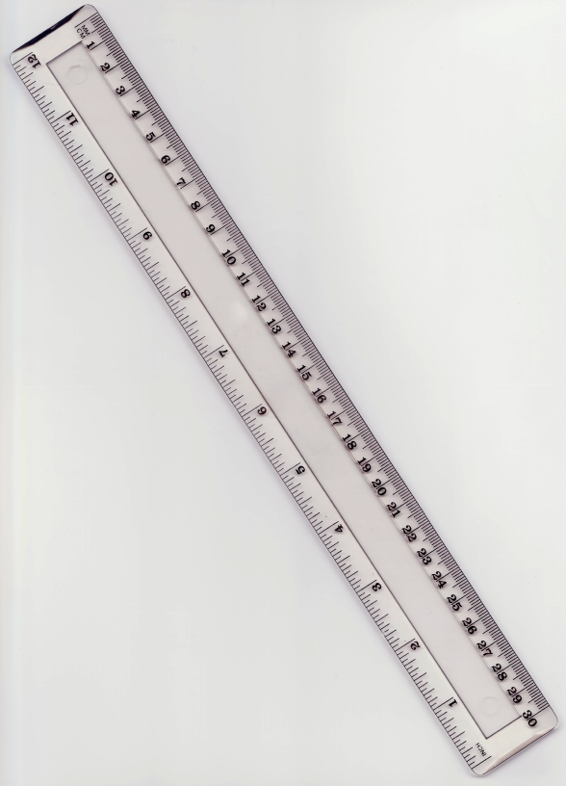
a. Find the area of a 6 m by 9 m rectangle.
b. Use the side lengths, 6 m × 9 m, to find
different side lengths for a rectangle that
has the same area. Show your equations
using parentheses. Then estimate to draw
the rectangle and label the side lengths.

Slide 62
Anil finds the area of a 5 inch by 17 inch rectangle by breaking it into 2 smaller rectangles. Show one way that he could have solved the problem. What is the area of the rectangle?

Slide 63
Break apart the shaded figure into 2 rectangles. Then add to find the area of the shaded figure below.
b. Subtract the area of the unshaded
rectangle from the area of the large
rectangle to check your answer in Part (a).

Slide 64
Anu needs to cut a piece of paper into 6 equal parts. Draw at least three pictures to show how Anu can cut her paper so that all the parts are equal.

Slide 65
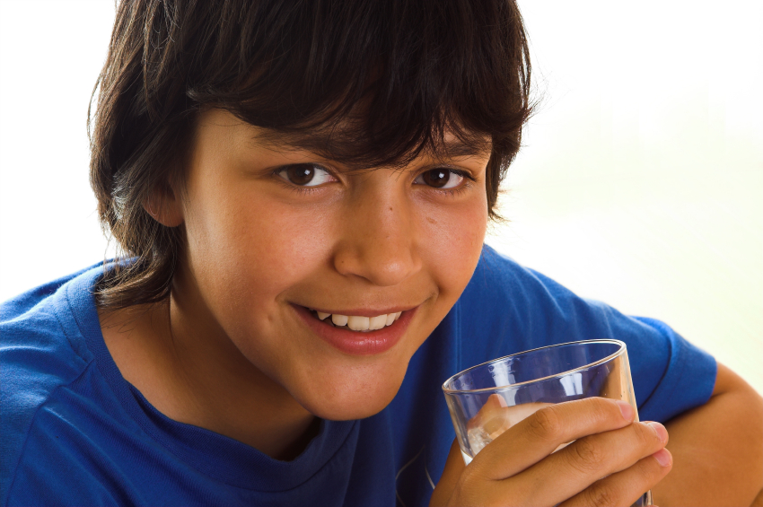
Marcos has a 1-liter container of milk he is going to share with his mother, father, and sister at dinner. Draw a picture to show how Marcos must share the container of milk so that all 4 of them get the same amount of milk. What fraction of the milk does each person get?

Slide 66
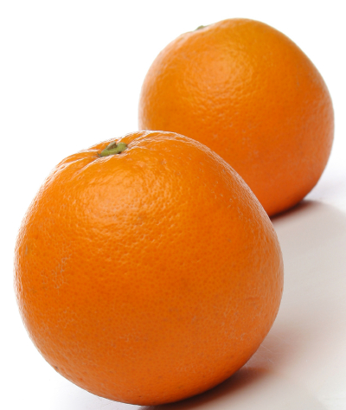
Mr. Ramos sliced an orange into 8 equal pieces. He ate 1 slice. Draw a picture to represent the 8 slices of an orange. Shade in the slice Mr. Ramos ate. What fraction of the orange did Mr. Ramos eat? What fraction did he not eat?

Slide 67
Ms. Browne cut a 6 meter rope into 3 equal size pieces to make jump ropes. Mr. Ware cut a 5 meter rope into 3 equal size pieces to make jump ropes. Which class has longer jump ropes?
(Bonus: How long are the jump ropes in Ms. Browne’s class?)

Slide 68
Chloe’s dad partitions his garden into 4 equal size sections to plant tomatoes, squash, peppers, and cucumbers. What fraction of the garden is available for growing tomatoes?
(Bonus: Chloe talked her dad into planting beans and lettuce too. He used equal size sections for all the vegetables. What fraction do the tomatoes have now?)

Slide 69
Robert was snacking on a small container of applesauce. He ate half of the container. His mother and sister were upset he didn’t save much for them. So he split up the remaining applesauce into 2 bowls. Robert said, “I ate 1 half, and each of you got 1 half.” Is Robert right? Draw a picture to prove your answer.
Bonus Questions:
What fraction of the apple sauce did his mother get?
Why can’t the container be partitioned into 3 equal parts?
What fraction of the applesauce did Robert’s sister eat?

Slide 70
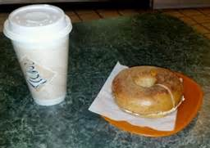
Mr. Schwartz went to a coffee shop before school. He spent 1 sixth of his money on a coffee and 1 sixth of his money on a bagel with cream cheese. How much of his money did Mr. Schwartz spend before school?

Slide 71
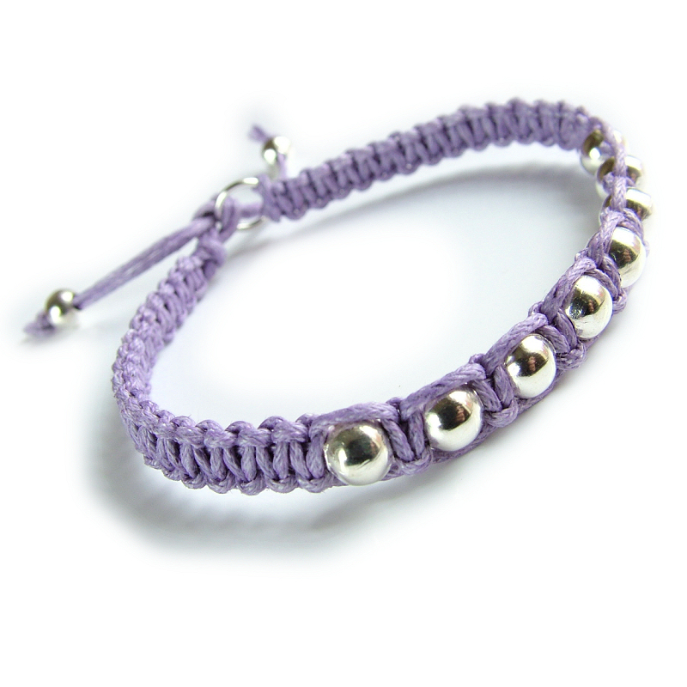
Julianne’s friendship bracelet has 8 beads. When it broke, the beads fell off. She could only find 1 of the beads. To fix her bracelet, what fraction of the beads does she need to buy?

Slide 72
Sarah makes soup. She divides each batch equally into thirds to give away. Each family that she makes soup for gets 1 third of a batch. Sarah needs to make enough soup for 5 families. How much soup does Sarah give away? Write your answer in terms of batches.
Bonus: What fraction will be left over for Sarah?

Slide 73
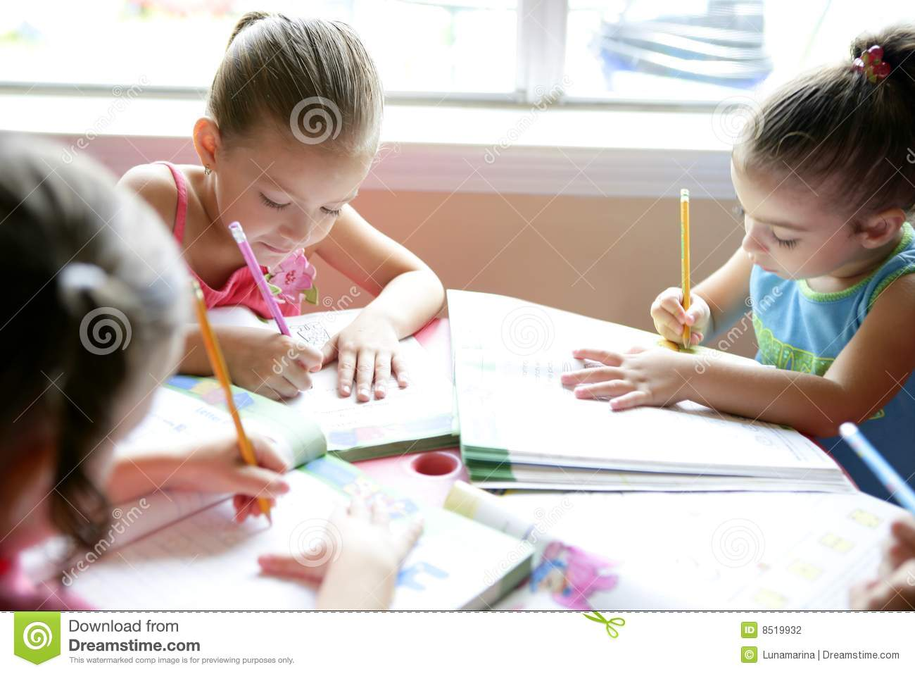
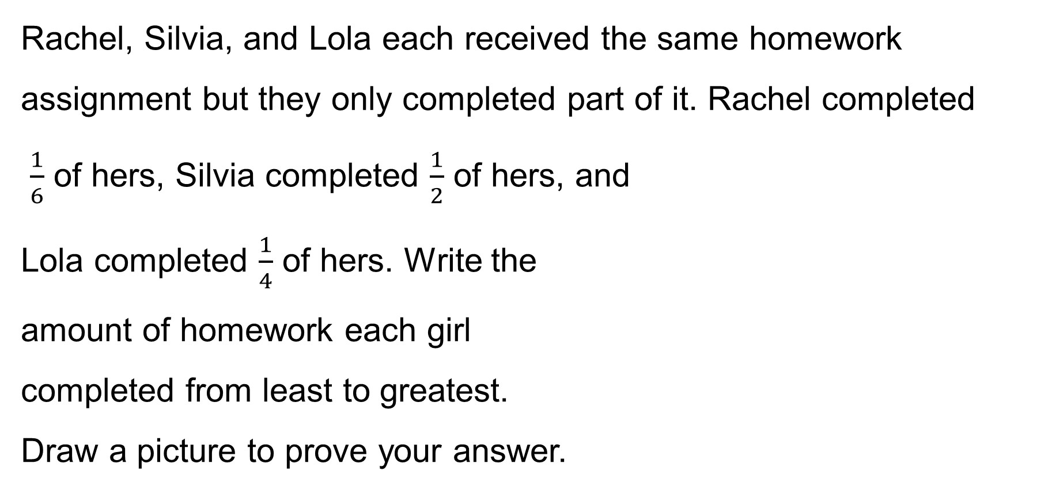
Rachel, Silvia, and Lola each received the same homework assignment but they only completed part of it. Rachel completed
$\frac{1}{6}$ of hers, Silvia completed $\frac{1}{2}$ of hers, and
Lola completed $\frac{1}{4}$ of hers. Write the
amount of homework each girl
completed from least to greatest.
Draw a picture to prove your answer.

Slide 74
Jennifer hid half her birthday money in the top drawer of her dresser. The other half she put in her jewelry box. If she hid $8 in her top drawer, how much money did she get for her birthday?

Slide 75
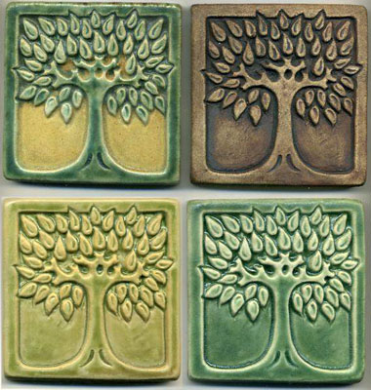
Davis wants to make a picture using 9 square tiles. What fraction of the picture does 1 tile represent? Draw 3 different ways Davis could make his picture.

Slide 76
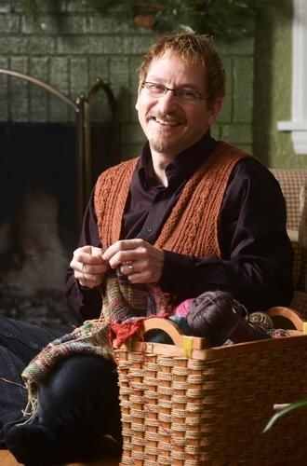
Mr. Ray is knitting a scarf. He says that he has completed 1 fifth of the total length of the scarf.
Draw a picture of the final scarf. Label what he has finished and what he still has to make. Draw a number bond with 2 parts to show the fraction he has made and the fraction he has not made.

Slide 77
In baseball, it is about 30 yards from home plate to first base. The batter got tagged out about half way to first base. About how many yards from home plate was he when he got tagged out? Draw a number line to show the point where he was when tagged out.

Slide 78
Hannah bought 1 yard of ribbon to wrap 4 small presents. She wants to cut the ribbon into equal parts. Draw and label a number line from 0 yd. to 1 yd. to show where Hannah will cut the ribbon. Label all the fractions including 0 fourths and 4 fourths. Label 0 yd. and 1 yd., also.

Slide 79
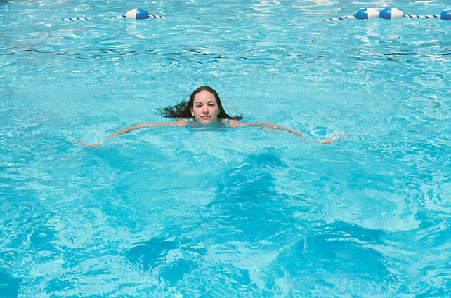
Sammy goes to the pool. She sees a black line at the bottom stretching from one end of the pool to the other. She wonders how long it is. The black line is the same length as 9 concrete slabs that make the sidewalk at the edge of the pool. One concrete slab is
5 meters long. What is the length of the black line at the bottom of the pool?

Slide 80
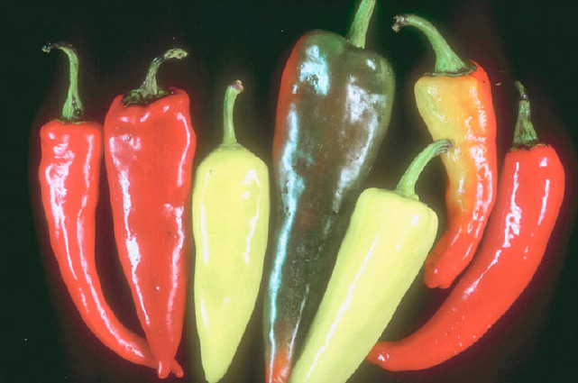
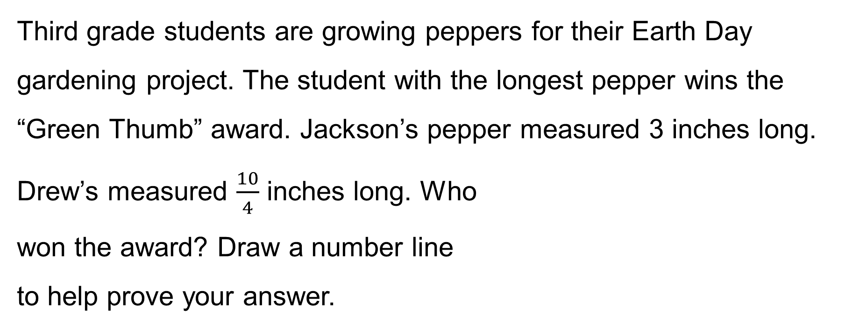
Third grade students are growing peppers for their Earth Day gardening project. The student with the longest pepper wins the “Green Thumb” award. Jackson’s pepper measured 3 inches long. Drew’s measured $\frac{10}{4}$ inches long. Who
won the award? Draw a number line
to help prove your answer.

Slide 81
Thomas has 2 sheets of paper. He wants to punch 4 equally spaced holes along the edge of each sheet.
Draw Thomas’ 2 sheets of paper next to each other so the ends meet. Label a number line from 0 at the start of his first paper to 2 at the end of his second paper. Show Thomas where to hole-punch his papers and label the unit fractions. What unit fraction is labeled on the eighth hole?

Slide 82
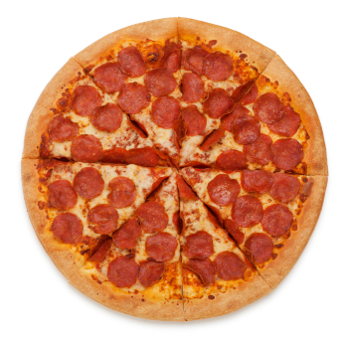
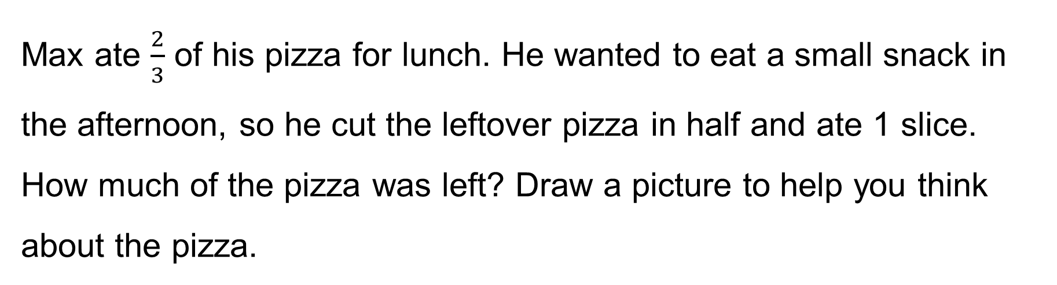
Max ate $\frac{2}{3}$ of his pizza for lunch. He wanted to eat a small snack in the afternoon, so he cut the leftover pizza in half and ate 1 slice. How much of the pizza was left? Draw a picture to help you think about the pizza.

Slide 83
Dorothea is training to run a 2 mile race. She marks off her starting point and the finish line. So that she can track her progress, she places a mark at 1 mile. She then places a mark halfway between her starting position and 1 mile, and another halfway between 1 mile and the finish line.
Draw a number line to show what unit fraction she makes as she marks the points on her run.
How far has she run when she gets to the third marker?

Slide 84
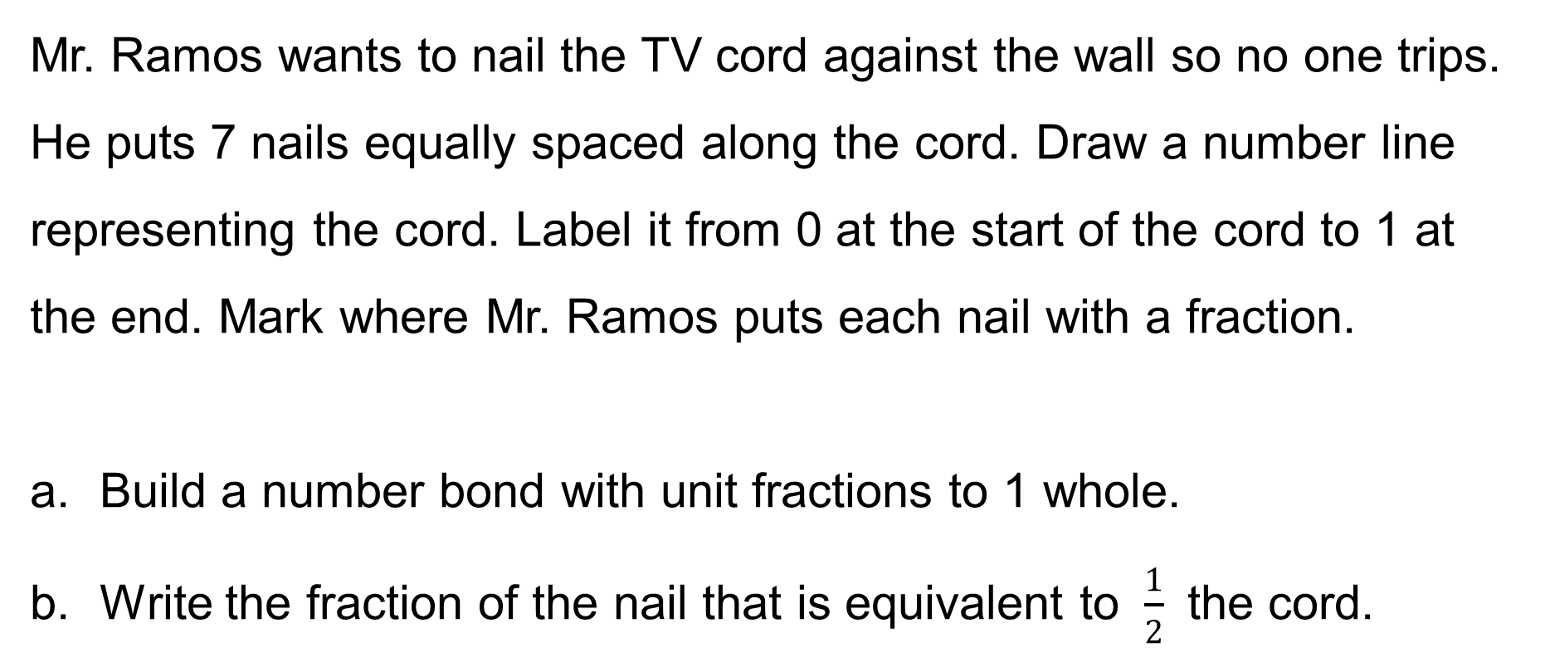
Mr. Ramos wants to nail the TV cord against the wall so no one trips. He puts 7 nails equally spaced along the cord. Draw a number line representing the cord. Label it from 0 at the start of the cord to 1 at the end. Mark where Mr. Ramos puts each nail with a fraction.
Build a number bond with unit fractions to 1 whole.
Write the fraction of the nail that is equivalent to $\frac{1}{2}$ the cord.

Slide 85
The soccer player stood at the corner of a 100 meter field and kicked the ball to her teammate. She kicked it 20 meters. The commentator said she kicked it a quarter of the way across the field. Is that true? If not, what fraction should the commentator have said? Prove your answer by using a number line.

Slide 86
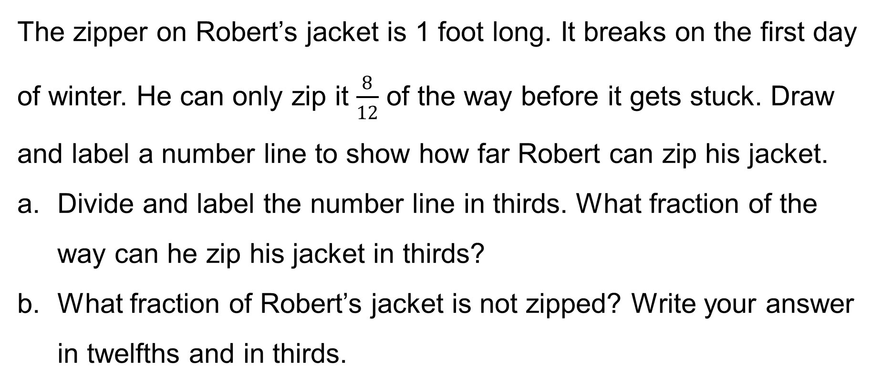
The zipper on Robert’s jacket is 1 foot long. It breaks on the first day of winter. He can only zip it $\frac{8}{12}$ of the way before it gets stuck. Draw and label a number line to show how far Robert can zip his jacket.
Divide and label the number line in thirds. What fraction of the way can he zip his jacket in thirds?
What fraction of Robert’s jacket is not zipped? Write your answer in twelfths and in thirds.

Slide 87
Linc drinks 1 eighth gallon of milk every morning.
How many days would it take for him to drink 1 gallon of milk? Use a number line and words to explain your answer.
How many days would it take him to drink 2 gallons? Extend your number line to show 2 gallons and use words to explain your answer.

Slide 88
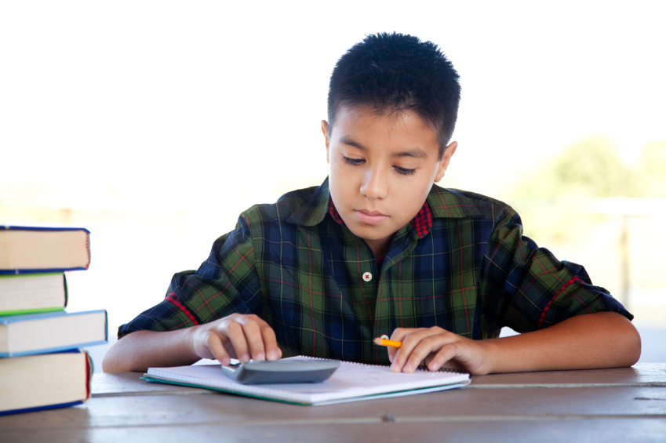
Antonio works on his project for 4 thirds of an hour. His mom tells him that he must spend another 2 thirds hour on it. Draw number bonds and a number line with copies of thirds to show how long Antonio worked altogether.

Slide 89
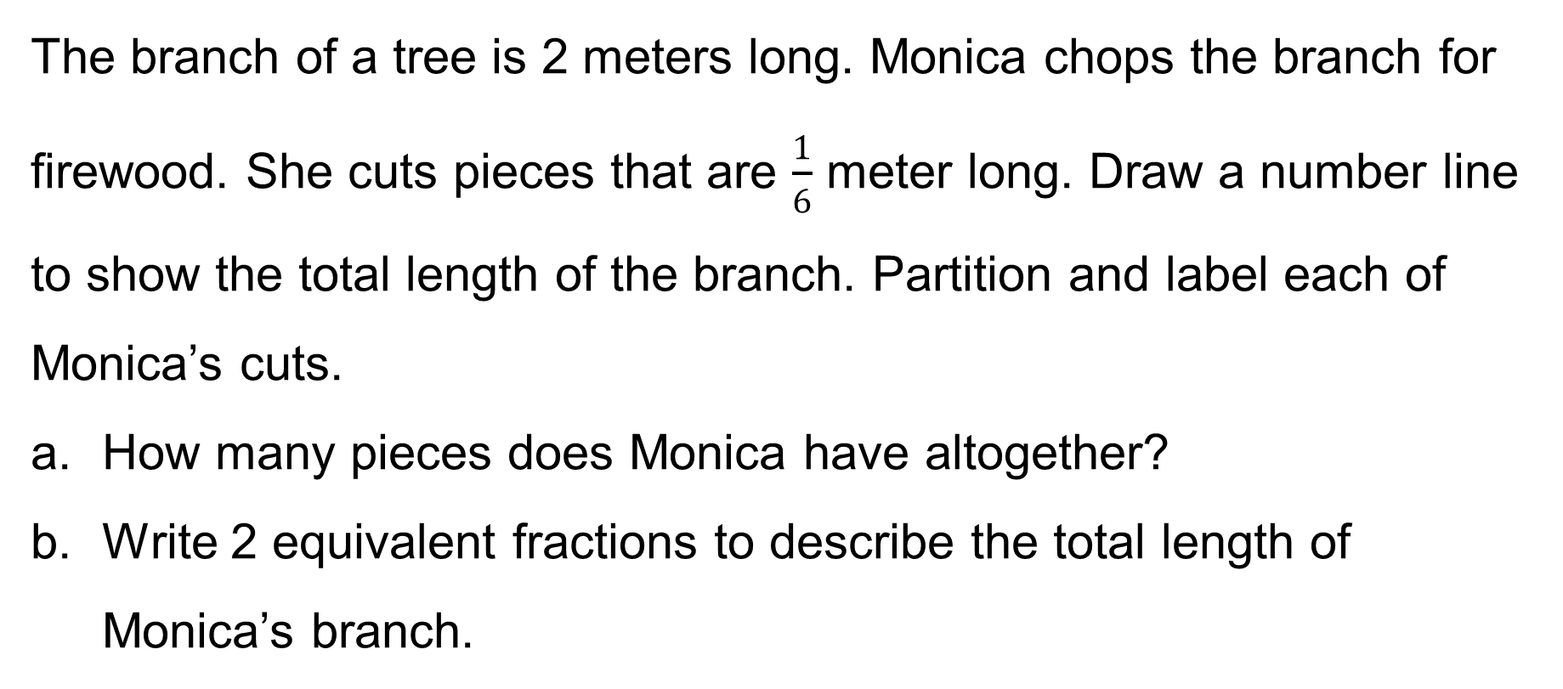
The branch of a tree is 2 meters long. Monica chops the branch for firewood. She cuts pieces that are $\frac{1}{6}$ meter long. Draw a number line to show the total length of the branch. Partition and label each of Monica’s cuts.
How many pieces does Monica have altogether?
Write 2 equivalent fractions to describe the total length of Monica’s branch.

Slide 90


LaTonya has 2 equal sized hotdogs.
She cut the first one into thirds at
lunch. Later she cut the second
hotdog to make double the number
of pieces. Draw a model of LaTonya’s hotdogs.
How many pieces is the second hotdog cut into?
If she wants to eat $\frac{2}{3}$ of the second hotdog, how many pieces should she eat?

Slide 91


Catherine and Diana bought matching scrapbooks. Catherine decorated $\frac{5}{9}$ of the pages in her book. Diana decorated $\frac{5}{6}$ of the pages in her book. Use a tape diagram to show who has decorated more pages of their scrapbooks.

Slide 92

Damien folds a paper strip into 6 equal parts. He shades 5 of the equal parts and then cuts off 2 shaded parts. Explain your thinking about what fraction is unshaded.

Slide 93
Reisha plays in three basketball games. She scores 12 points in Game 1, 8 points in Game 2, and 16 points in Game 3. Each basket that she made was worth 2 points. She uses tape diagrams with a unit size of 2 to represent the points she scored in each game. How many total units of 2 will it take to represent the points she scored in all three games?

Slide 94
The vertical tape diagram shows the number of fish in Sal’s Pet Store.
Find the total number of fish in Tank C. Show your work.
Tank B has a total of 30 fish. Draw the tape for Tank B.
How many more fish are in Tank B than in Tanks A and D combined?
Number of Fish in Sal’s Pet Store
5
5
5
5
5
5
5
5
5
5
5
5
5
5
Tank
A
Tank
B
Tank
C
Tank
D
Tank
E

Slide 95
Insect | Number of Wing Vibrations Each Second
Honeybee | 350
Beetle | b
Fly | 550
Mosquito | m
The following chart shows the number of times
an insect’s wings vibrate each second. Use the
following clues to complete the unknowns in
the chart.
The beetle’s number of wing vibrations is the same as the difference between the fly and honeybee’s.
The mosquito’s number of wing vibrations is the same as 50 less than the beetle and fly’s combined.

Slide 96

Katelynn measures the height of her bean plant on Monday and again on Friday. She says that her bean plant grew 10 quarter inches. Her partner records

Slide 97

The chart shows the lengths of straws measured in Mr. Han’s class.
How many straws were measured? Explain how you know.
What is the smallest and greatest measurement on the chart?
Were the straws measured to the nearest inch? How do you know?
Straw Lengths (in Inches)
3 | 4 | $$\text{4}\frac{1}{2}$$ | $$\text{2}\frac{3}{4}$$ | $$\text{3}\frac{3}{4}$$
$$\text{3}\frac{3}{4}$$ | $$\text{4}\frac{1}{2}$$ | $$\text{3}\frac{1}{4}$$ | 4 | $$\text{4}\frac{3}{4}$$
$$\text{4}\frac{1}{4}$$ | 5 | 3 | $$\text{3}\frac{1}{2}$$ | $$\text{4}\frac{1}{2}$$
$$\text{4}\frac{1}{2}$$ | 4 | $$\text{3}\frac{1}{4}$$ | 5 | $$\text{4}\frac{1}{4}$$

Slide 98


Mrs. Byrne’s class is studying worms. They measure the lengths of the worms to the nearest quarter inch. The length of the shortest worm is $\text{3}\frac{3}{4}$ inches. The length of the longest worm is $\text{5}\frac{2}{4}$ inches. Kathleen says they will need 8 quarter inch intervals to plot the lengths of the worms on a line plot. Is she right? Why or why not?

Slide 99

Marla creates a line plot with a half-inch scale from 33 to 37 inches. How many tick marks will be on her line plot?

Slide 100

The third-graders raised $437 in a fundraiser. The fourth-graders raised $68 less than the third-graders. How much money did the two grade levels raise altogether?

Slide 101

Frankie says that all squares are rectangles, but not all rectangles are squares. Do you agree with this statement? Why or why not? Draw diagrams to support your statement.

Slide 102

Name at least two attributes that a trapezoid, a square, and a parallelogram all have in common. Draw a diagram to support your ideas.

Slide 103
Trista uses all seven of her tangram pieces to make a square as shown. One side of the large square is 4 inches long. What is the total area of the two large triangles? Explain your answer.
4 in

Slide 104

Angela measures the sides of a square napkin with her ruler. Each side measures 6 inches. What is the perimeter of the napkin?

Slide 105
Use your index card to answer the questions.
What is the perimeter of your index card in inches?
Place the short end of your index card next to the short end of your partner’s index card. Make a prediction: What do you think the perimeter is of the new shape you made?
Find the perimeter of the new shape. Was your prediction right? Why or why not?

Slide 106


A rectangular sheep pen measures 5 meters long and 9 meters wide. The perimeter of the cow pen is double the perimeter of the sheep pen. What is the perimeter of the cow pen?

Slide 107
Clara and Pedro each use four 3-inch by 5-inch cards to make the rectangles below. Whose rectangle has a greater perimeter?
3 cm
5 cm
Pedro’s Rectangle
3 cm
Clara’s Rectangle
5 cm

Slide 108

Mrs. Zeck will use 14 feet of tape to mark a rectangle on the gym wall. Draw several rectangles that Mrs. Zeck could make with her tape. Label the side lengths of each rectangle.

Slide 109

Drew makes rectangular shoes for his robot. Each shoe has whole number side lengths and an area of 7 square
centimeters. What is the total perimeter of both
shoes? Is there more than one answer?
Why or why not?

Slide 110

Mara draws a 6 inch by 8 inch rectangle. She shades one-half of the rectangle. What is the area of the shaded part of Mara’s rectangle?

Slide 111
Hannah traces square-inch tiles to draw 3 larger squares. She draws the 3 large squares side by side to make a rectangle. She shades one-half of each larger square, as shown.
Do you agree that all 3 squares are one-half shaded? Explain your answer.
What is the area of the rectangle?
What is the total area of the shaded space?

Slide 112

There are 9 bicycles and some tricycles at the repair shop. There are 42 total wheels on all the bicycles and tricycles. How many tricycles are in the shop?

