Slide 1
Grade 2
Mathematics Application Problems

Slide 2
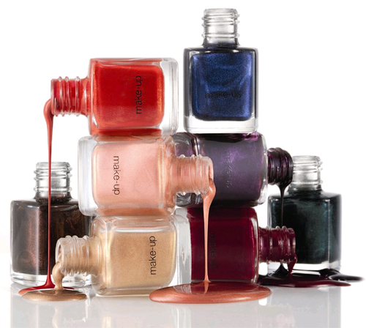
Mrs. Potter paints her fingernails one at a time
from left to right. If she paints 1 fingernail,
how many fingernails will she have unpainted?
How many other combinations of painted and
unpainted nails can she have?

Slide 3
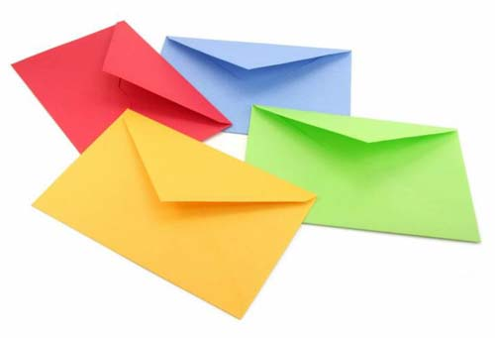
The cashier puts exactly 10 bills inside each envelope. How many more bills does he need to put in each of the following envelopes?
  An envelope with 9 bills.
  An envelope with 5 bills.
  An envelope with 1 bill.

Slide 4
A different cashier puts exactly 30 bills in each envelope. How many more bills does he need to put in each of the following envelopes?
  An envelope with 28 bills.
  An envelope with 22 bills.
  An envelope with 24 bills.

Slide 5
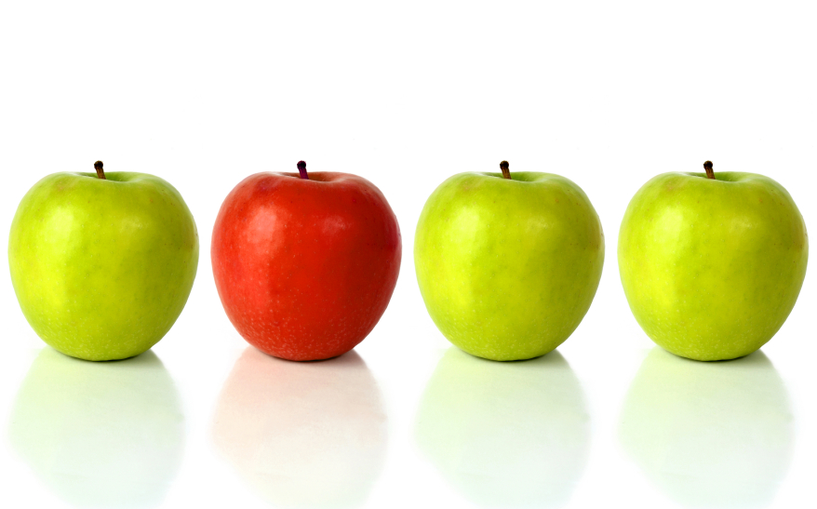
There are both red and green apples in a bag. How many red and how many green apples might there be in the bag?

Slide 6
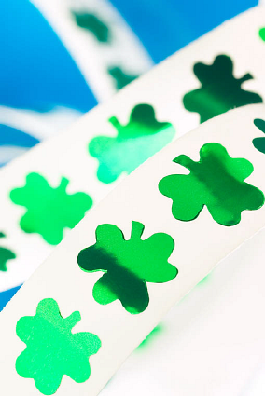
Sherry already has 10 stickers. Now her goal is to collect 20 in all. She got 4 more on Monday and 4 again on Tuesday.
        How many does she have in all?
        How many more does she need to make her goal?
        How many does she need if her goal is to collect 30 stickers?

Slide 7
Ben and Chuck collect dimes. They do it by first collecting pennies and then trading with their parents 10 pennies for 1 dime. Ben has 8 pennies and Chuck has 9 pennies. They each find 4 more pennies.
How many pennies does each boy have before they trade?
How many extra pennies does each boy have after they trade?
How many more pennies does each boy need before he can trade for another dime

Slide 8
Melia and Maya both love animals. Melia counted 17 puppies in one cage at the animal shelter and 3 in another cage. Maya counted 13 kittens in one cage and 7 in another.
  How many kittens are there in all?
  How many puppies are there in all?
  Write a sentence comparing the number of puppies and kittens.

Slide 9
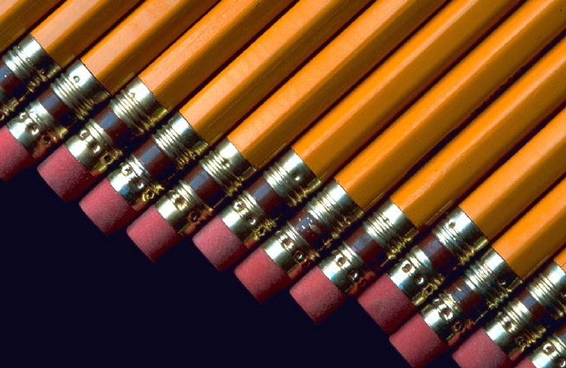
Pencils come 12 to a package. Shane gives
some pencils to his friends. Now he has 7 left.
How many pencils did he give away?

Slide 10
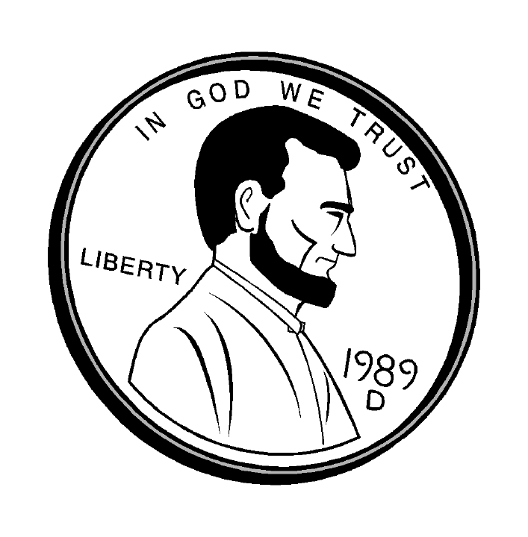
Sylvia has a dime and three pennies. A friend asked her for 8 cents.
  What can Sylvia do to be able to give her friend 8 cents?
  How much money would she have left after giving away 8 cents?

Slide 11
One box fits exactly 10 cans. On Monday, Maria packed cans into boxes, making sure to fill a box before beginning a new one. On Tuesday she added 6 more cans.
  How many boxes were completely filled then?
  How many cans did Maria pack in all?
(Extension) How many more cans did Maria need to fill another box?

Slide 12
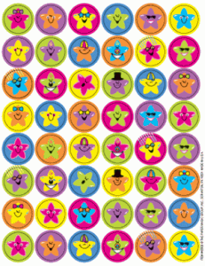
Kayla has 21 stickers. She gives Sergio 7 stickers. How many stickers does she have left?

Slide 13

At the lunch table, Mariana, Billy, and Emma are eating carrot sticks. Billy’s carrot sticks are longer than Emma’s, and Mariana’s carrot sticks are longer than Billy’s. If Mariana’s carrot sticks are 12 centimeters long, is it possible that Emma’s carrot sticks are 7 centimeters long? Draw a picture and use words to explain your thinking. What is one possible length for Billy’s carrot sticks?

Slide 14
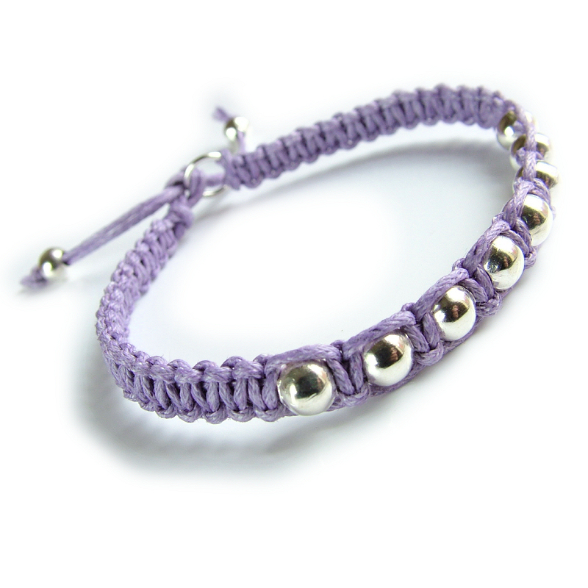
Kaela is making 4 bracelets, and she wants them to be the same length. She found a jar of square Lego pieces that are all about the size of her thumbnail. How can she use these Lego pieces to measure the length of the bracelets? Draw a picture and use words to explain your thinking. What could Kaela do if she only had one Lego piece?

Slide 15
Jared’s parents buy him a new bed, but they are not sure if it is short enough to fit against his bedroom wall. Jared only has his dad’s construction boot and a popsicle stick as measurement tools. Which measurement strategy would you suggest to Jared. Can Jared figure out if the new bed will fit in his bedroom? How do you know? Use numbers, pictures, or words to explain your thinking.
Extension: Which tool would you use to measure, the popsicle stick or the construction boot? Why?

Slide 16
Cameron wants to draw a canoe that is 16 centimeters long. He has 16 centimeter cubes, a centimeter ruler, and 16 paperclips of various sizes in his desk. Which measurement tool would you recommend for Cameron? Why? Write a sentence to explain your thinking. What if Cameron was asked to paint a much larger, life-size canoe as scenery for the school play? Is there any other way he could measure it?

Slide 17
Jenna and Bobby are building a rope ladder for their treehouse. They would like the ladder to be about the length of a sports car. They want to use rope for the sides of the ladder and wooden rungs for the steps. Which measurement tools would you suggest that Jenna and Bobby use to measure the length of the rope and the length of the rungs for their ladder? Draw a picture and use words to explain your thinking.

Slide 18
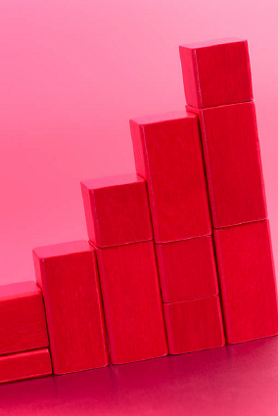
Eve builds a block tower that reaches the height of her bedroom doorknob, which is one meter high. Her little sister knocks some blocks down. Eve measures her new tower, and it is 48 centimeters tall. How does Eve’s new tower compare to when it was first built? Draw a picture on your personal board and use numbers or words to explain your thinking.

Slide 19

Natalia, Chloe, and Lucas are making clay snakes. Natalia's snake is 16 centimeters. Chloe's snake is 5 centimeters shorter than Natalia's. How long is Chloe's snake? Draw a picture and use numbers to explain your thinking.
Lucas's snake is 3 centimeters longer than Chloe's snake. Who has the longest snake: Natalia, Lucas, or Chloe? Add to your picture and use numbers to explain your thinking.

Slide 20
For Valentine's Day, Suzie is mailing a painting to her Nana. The painting is 16 centimeters long. The gift box is 35 centimeters long. How much longer is the gift box than the painting? Draw a picture to show your work.
Extension: What would happen if Suzie’s meter strip was torn and started at 1 centimeter instead of zero? Would she still be able to measure?

Slide 21
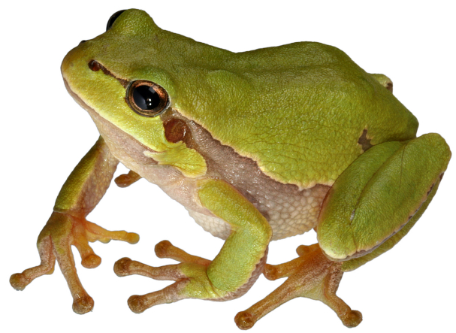
Mei’s frog leaped several centimeters. Then it leaped 34 centimeters. In all, it leaped 50 centimeters. How far did Mei’s frog leap at first? Draw a picture and write a number sentence to explain your thinking.

Slide 22
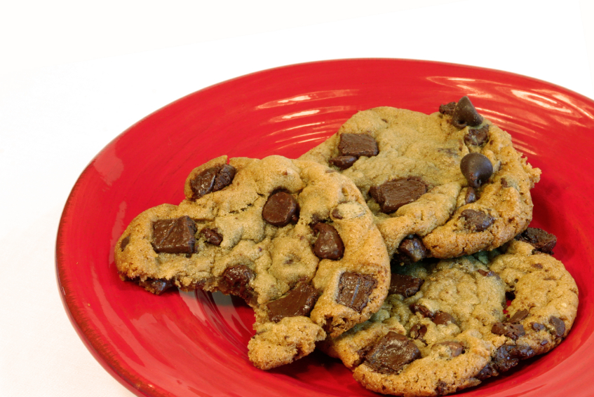
Ben and his dad have sold 60 chocolate chip cookies at the school bake sale. If they baked 100 cookies, how many cookies do they still need to sell?

Slide 23
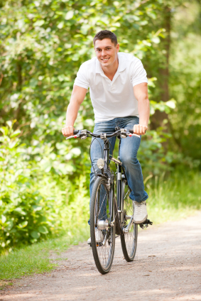
Kinnear decided that he would bike 100 miles this year. If he has biked 64 miles so far, how much farther does he have to bike?

Slide 24
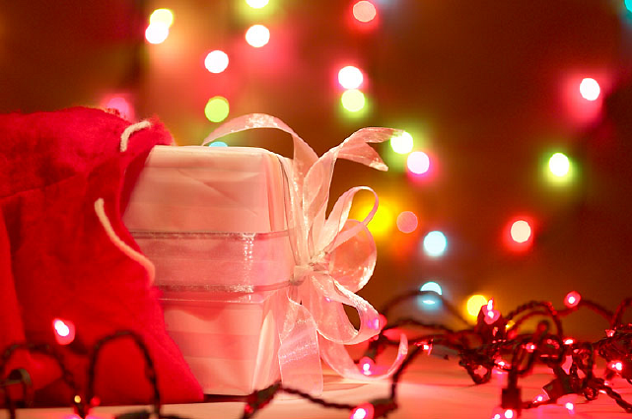
At his birthday party, Joey got $100 from each of his two grandmothers, $40 from his dad, and $5 from his little sister.
How much money did Joey get for his birthday?

Slide 25

Freddy has $250 in ten dollar bills.
  How many ten dollar bills does Freddy have?
  He gave 6 ten dollar bills to his brother. How many ten dollar bills does he have left?

Slide 26
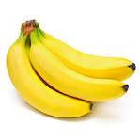
Timmy the monkey picked 46 bananas from the tree. When he was done, there were 50 bananas left. How many bananas were on the tree at first?

Slide 27
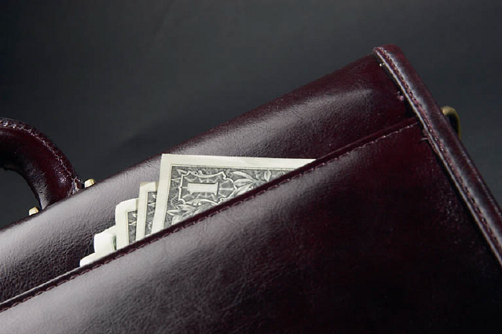
Billy found a briefcase full of money. He counted up 23 ten dollar bills, 2 hundred dollar bills, and 4 one dollar bills. How much money was in the briefcase?

Slide 28
Stacey has $154. She has 14 one dollar bills. The rest is in ten dollar bills. How many ten dollar bills does she have?

Slide 29
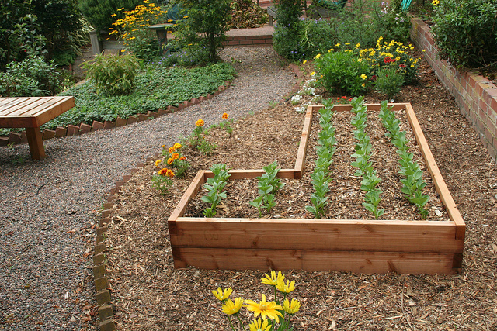
Sarah earns $10 each week for weeding the garden. If she saves all of the money, how many weeks will it take her to save up $150?

Slide 30
Jerry is a second grader. He was playing in the attic and found an old, dusty trunk. When he opened it, he found things that belonged to his grandfather. There was a cool collection of old coins and bills in an album. One bill was worth $1,000. Wow! Jerry lay down and started daydreaming. He thought about how good it would feel to give as many people as he could a ten dollar bill. He thought about how he had felt on his birthday last year when he got a card from his uncle with a ten dollar bill inside.
But even more, he thought about how lucky he felt one snowy, cold day walking to school when he found a ten dollar bill in the snow. Maybe he could quietly hide the ten dollar bills so that lots of people could feel as lucky as he did on that cold day! He thought to himself, “I wonder how many ten dollar bills are equal to a thousand dollar bill? I wonder how many people I could bring a lucky day to?”

Slide 31
Samantha is helping the teacher organize the pencils in her classroom for the teacher. She finds 41 yellow pencils and 29 blue pencils. She threw away 12 that were too short. How many pencils are left in all?

Slide 32
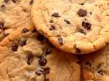
How many packages of 10 cookies can Collette make using 124 cookies? How many cookies does she need to complete another package of 10?

Slide 33
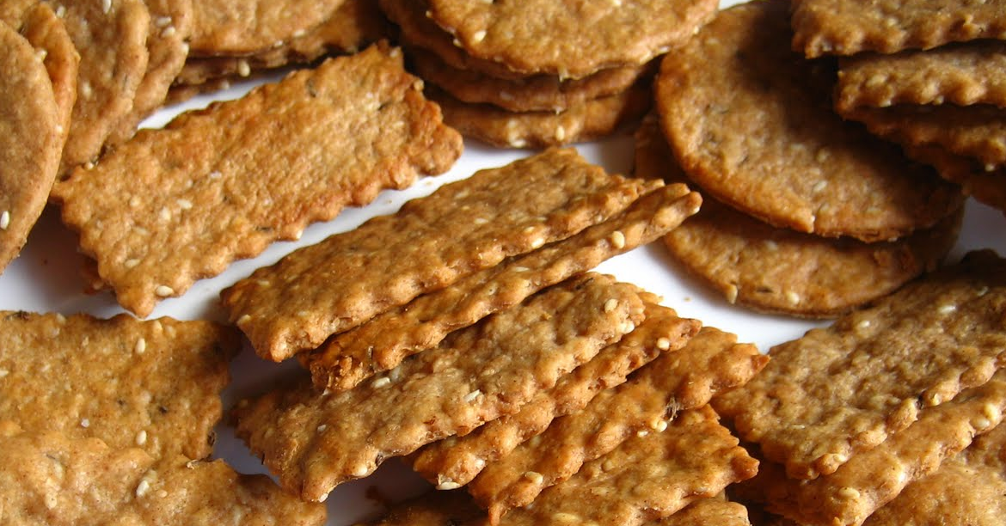
Sarah’s mom bought 4 boxes of crackers. Each box had 3 smaller packs of 10 inside. How many crackers were in the 4 boxes?

Slide 34
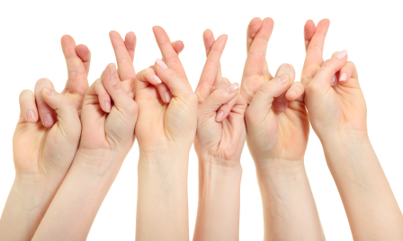
A second grade class has 23 students. What is the total number of fingers of the students?

Slide 35
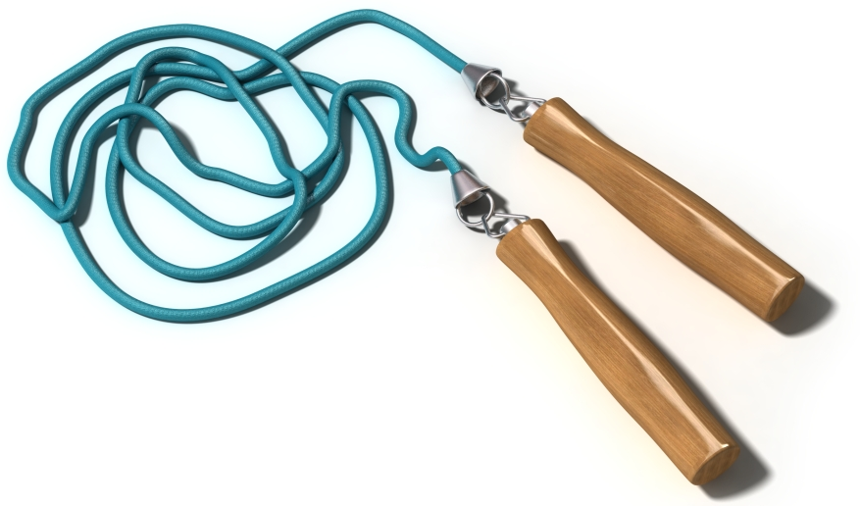
At recess Diane skip-roped 65 times without stopping. Peter skip-roped 20 times without stopping. How many more times did Diane skip-rope than Peter?

Slide 36
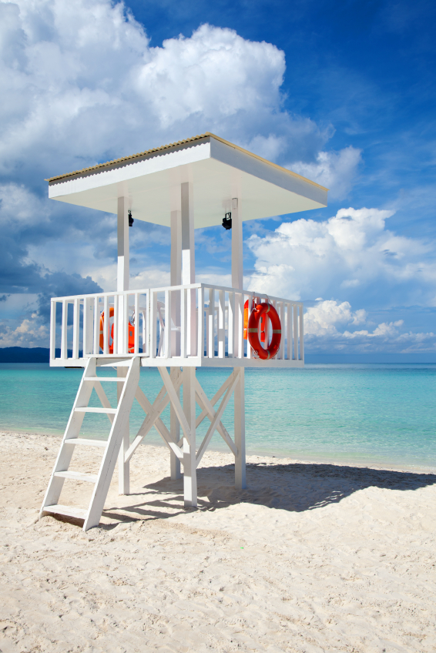
Walking on the beach on Tuesday, Darcy collected 35 rocks. The day before, she collected 28. How many fewer rocks did she collect on Monday than on Tuesday?

Slide 37

For an art project, Daniel collected 15 fewer maple leaves than oak leaves. He collected 60 oak leaves. How many maple leaves did he collect?

Slide 38
Mr. Palmer’s second grade class is collecting cans for recycling. Adrian collected 362 cans, Jade collected 392 cans, and Isaiah collected 562 cans.
  How many more cans did Isaiah collect than Adrian?
  How many less cans did Adrian collect than Jade?

Slide 39
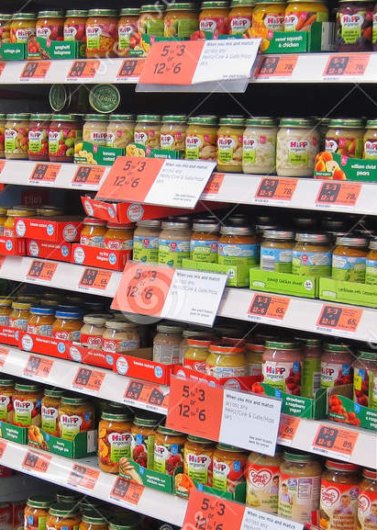
399 jars of baby food are sitting on the shelf at the market. Some jars fall off and break. 389 jars are still on the shelf. How many jars broke?

Slide 40
Rahim is reading a really exciting book! He’s on page 98.
If he reads 10 pages every day, what page will he be on in 3 days?

Slide 41
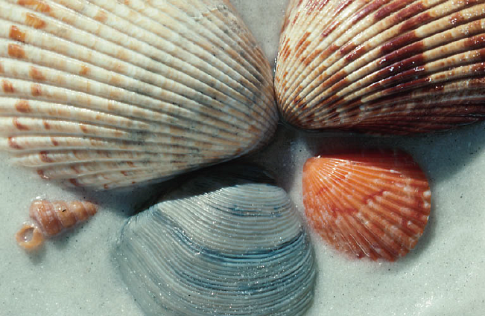
In the morning, Jacob found 23 seashells on the beach. In the afternoon, he found 10 more. In the evening, he found 1 more. How many seashells did Jacob find in all? If he gives 10 to his brother, how many seashells will Jacob have left?

Slide 42
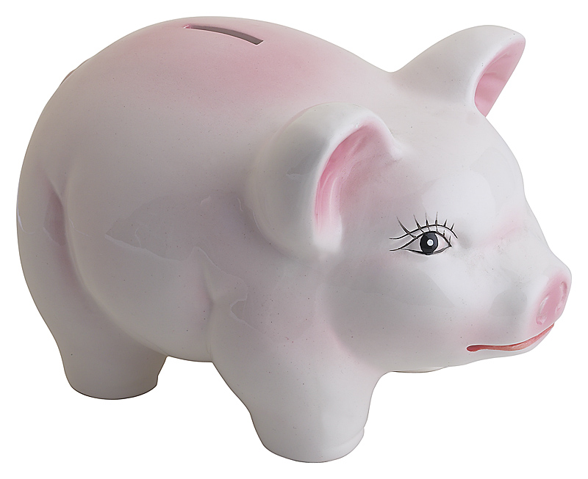
Susan has 57 cents in her piggy bank. If she just put in 30 cents today, how much did she have yesterday?

Slide 43
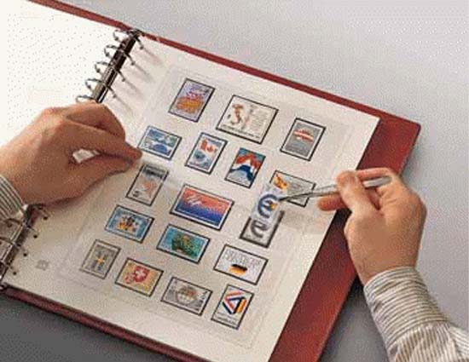
Terrell puts 19 stamps in his book on Monday. He puts in 32 stamps on Tuesday. How many stamps does Terrell put in his book? If Terrell’s book holds 90 stamps, how many more stamps does he need to fill his book?

Slide 44
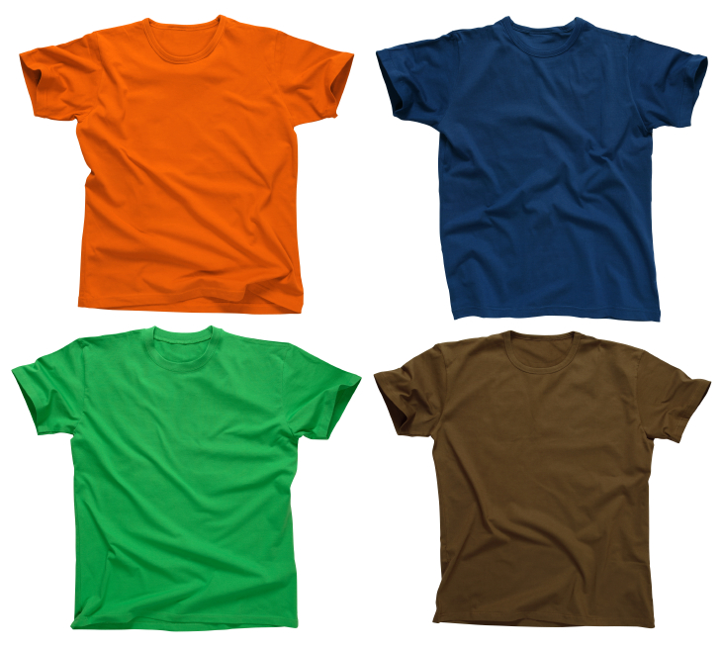
Carlos bought 61 t-shirts. He gave 29 of them to his friends. How many t-shirts does Carlos have left?

Slide 45
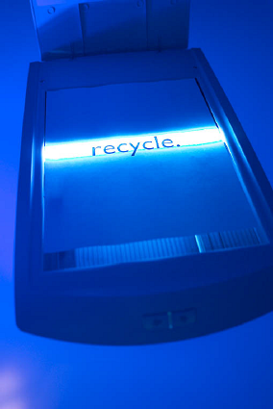
Mr. Wally’s class collects 36 cans for the recycling program. Then Azniv brings in 8 more cans. How many cans does the class have now?

Slide 46
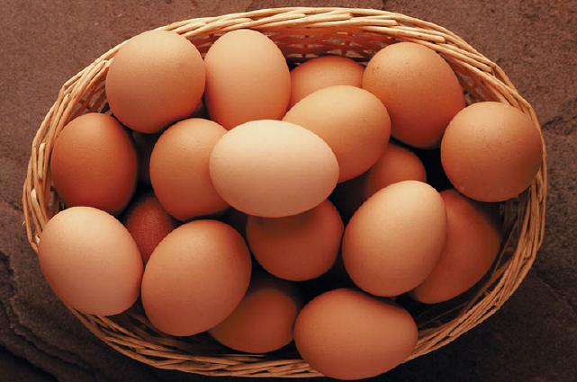
Farmer Andino’s chickens laid 47 brown eggs and 39 white eggs. How many eggs did the chickens lay in all?

Slide 47
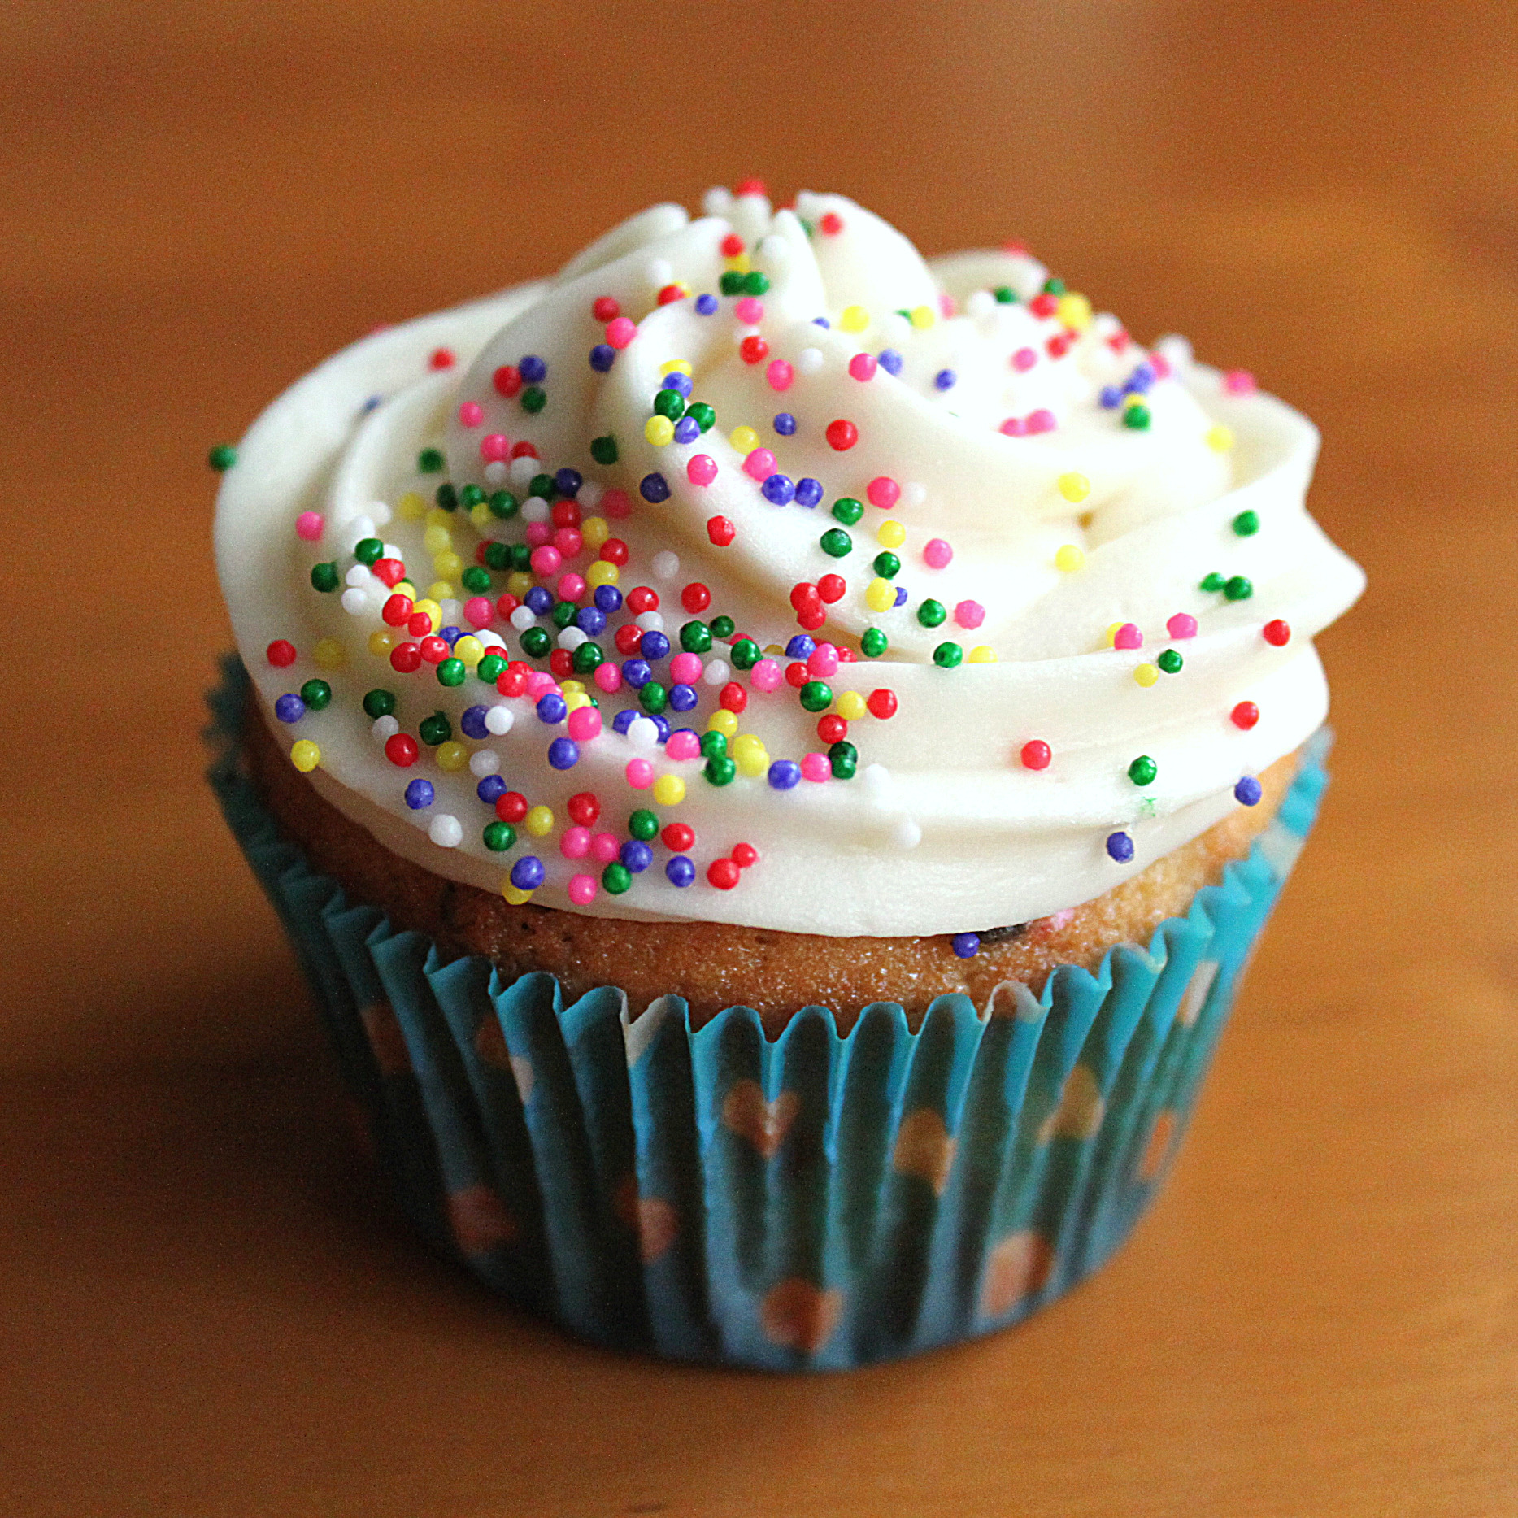
At the school fair, 29 cupcakes were sold and 19 were left over. How many cupcakes were brought to the fair?

Slide 48
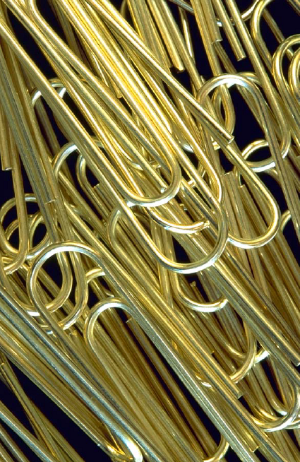
Marla spilled a box of paper clips. They landed on her desk and on the floor. 20 of them landed on her desk, and 5 more fell on the floor than landed on her desk. How many paper clips did she spill?

Slide 49
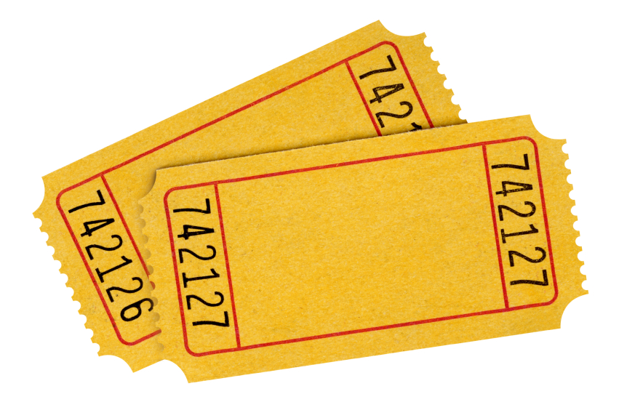
Moses sold 24 raffle tickets on Monday and 4 fewer on Tuesday. How many tickets did he sell in all on both days?

Slide 50
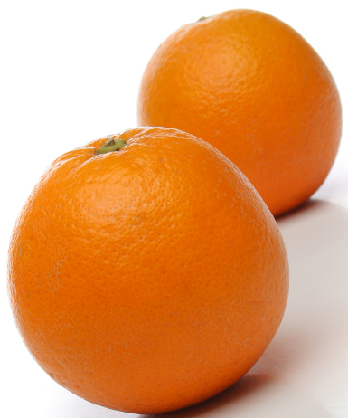
Shelby picks 35 oranges. 5 are rotten. How many of Shelby’s oranges are not rotten?
Rosa picks 35 oranges, too, but 6 are rotten. How many of Rosas oranges are not rotten?

Slide 51
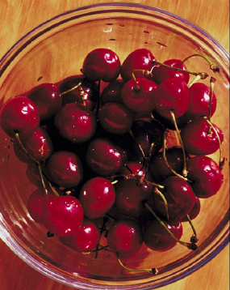
Barb has a bag of 34 cherries. She eats 17 cherries for a snack. How many cherries does she have left?

Slide 52
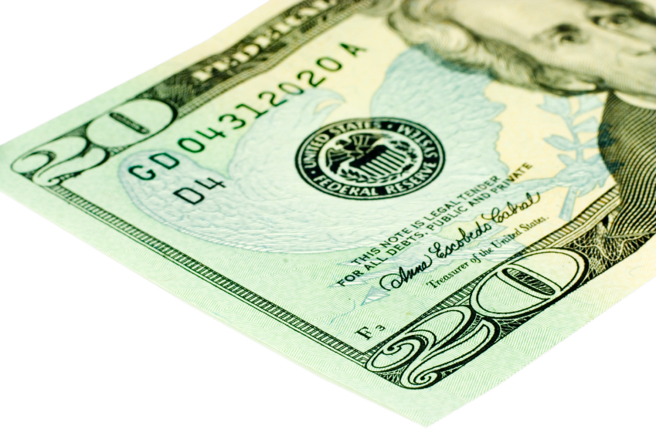
Mrs. Beachy went shopping with $42. She spent $18. How much money did she have left?

Slide 53
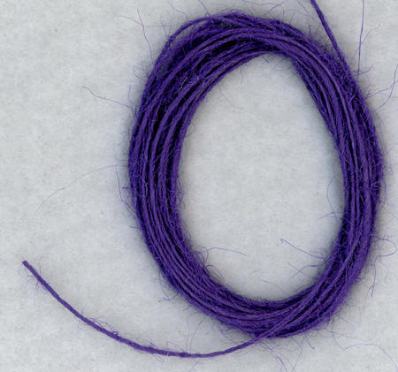
The total length of a red string and a purple string is 73 cm. The red string is 18 cm long. How long is the purple string?

Slide 54
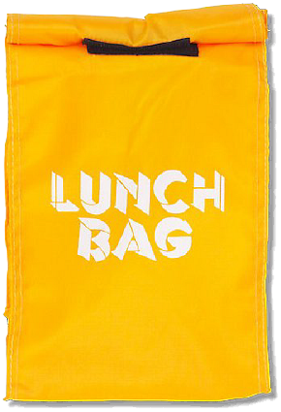
There are 136 students in the second grade at Miles Davis Elementary. 27 of them brought sack lunches to school. The rest buy the hot lunch. How many students are buying a hot lunch?

Slide 55
Erasers come in boxes of 10. Victor has 14 boxes. Gabby has 5 boxes.
How many erasers does Victor have?
How many erasers does Gabby have?
If Gabby gets another box, how many erasers do they have in all

Slide 56
Hailey and Gio solve 56 + 85. Gio says the answer is 131. Hailey says the answer is 141. Explain whose answer is correct using numbers, pictures, or words.

Slide 57
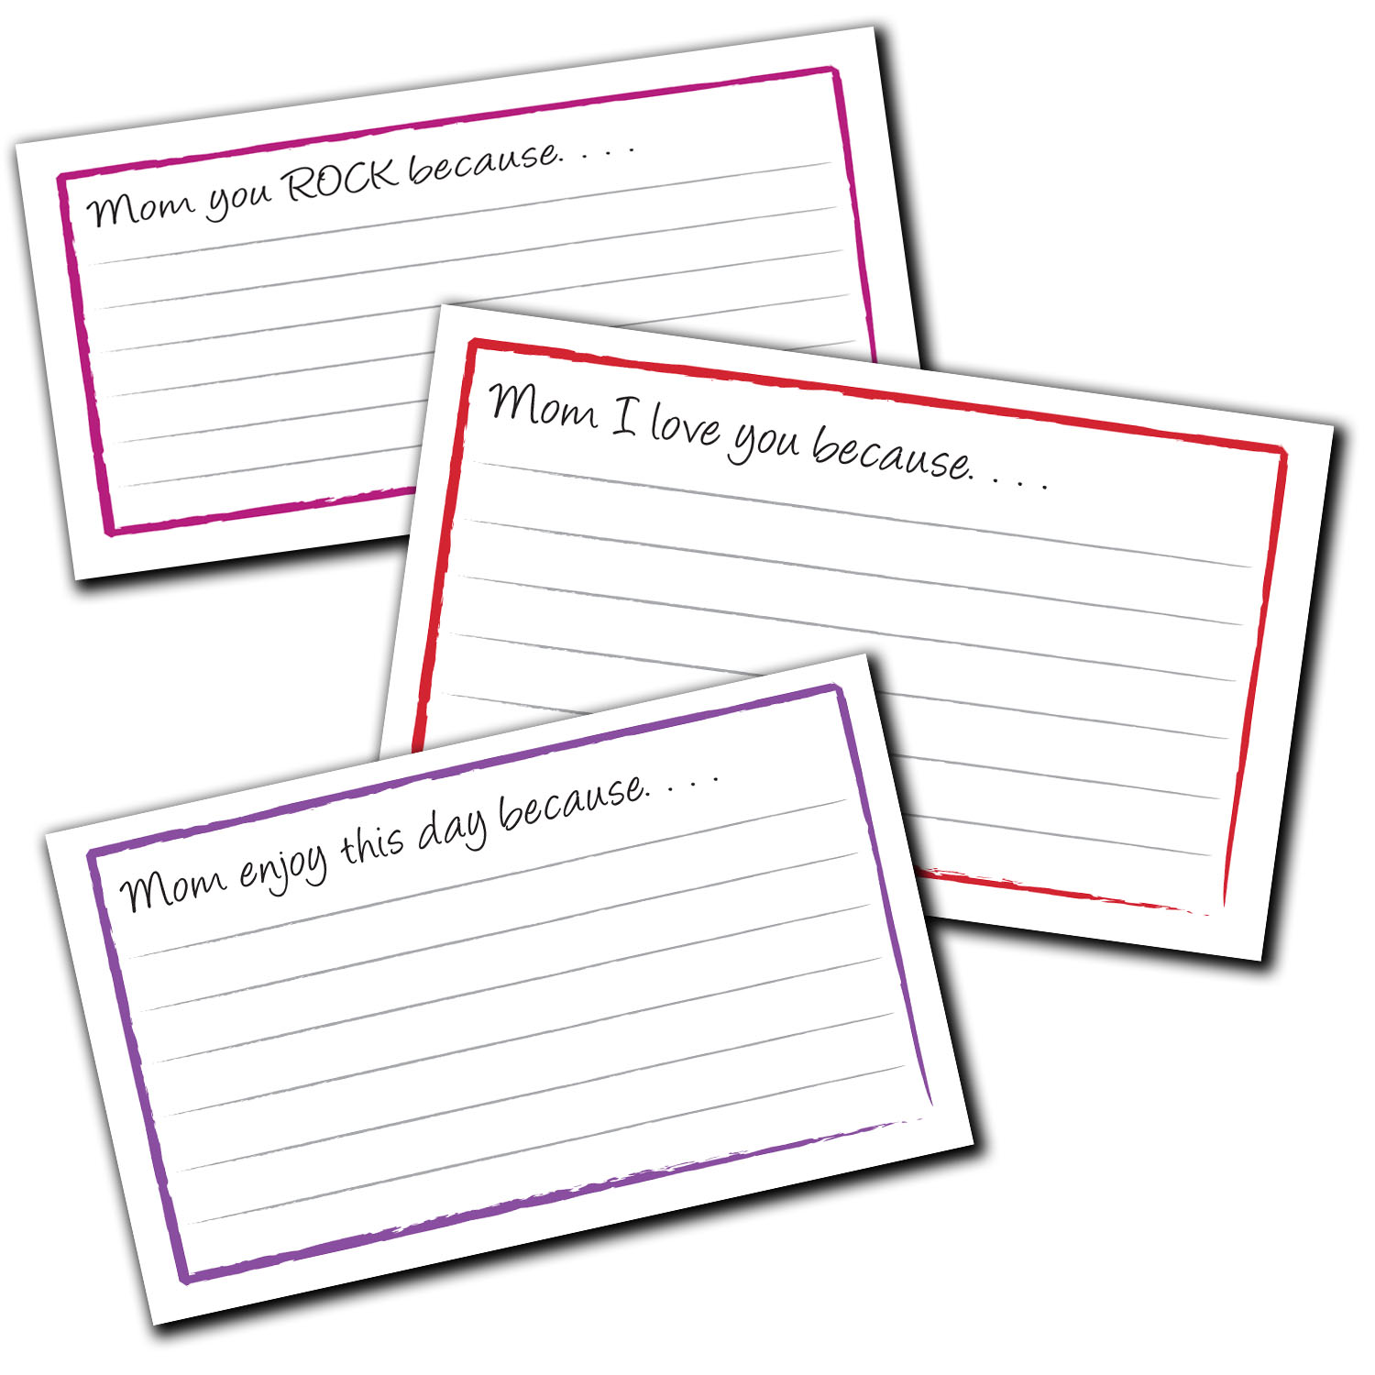
There are 35 note cards in one box. The other box holds 67 cards. How many cards are there in all?

Slide 58
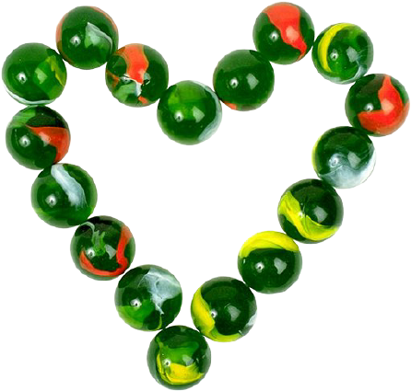
Kendra and Jojo are counting their marbles. Kendra has 38 and Jojo has 62. Kendra says they have 100 marbles altogether, but Jojo says they have 90. Use words, numbers, or a model to prove who is correct.

Slide 59
Katrina has 23 stickers and Jennifer has 9. How many more stickers does Jennifer need to have as many as Katrina?

Slide 60
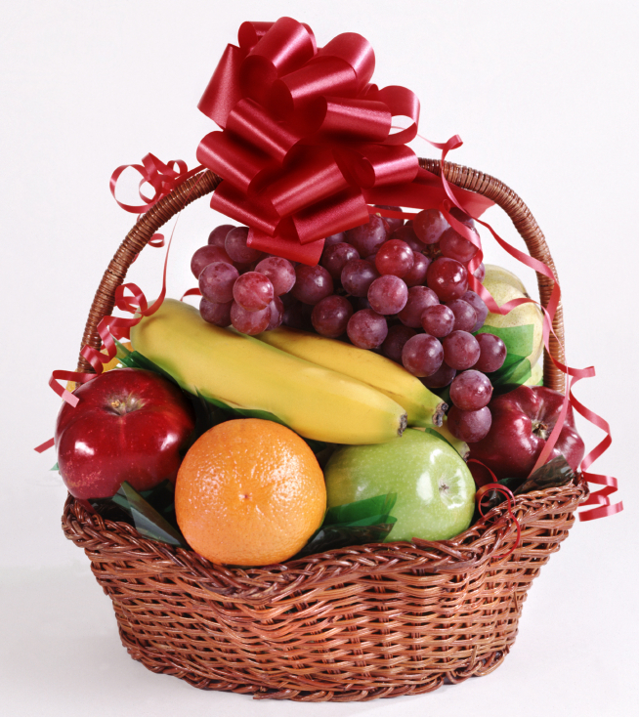
There are 38 apples, 16 bananas, 24 peaches, and 12 pears in the fruit basket. How many pieces of fruit are in the basket?

Slide 61
Yossef downloaded 115 songs. 100 of them were rock. The rest were hip-hop.
  How many of Yossef’s songs were hip-hop?
  80 of his rock songs were oldies. How many rock songs were new?

Slide 62
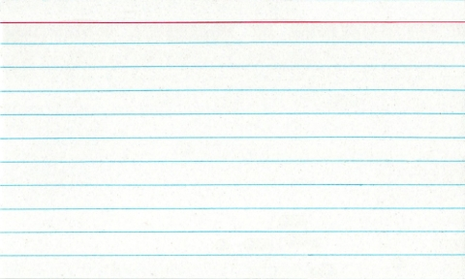
Sammy bought 114 notecards. He used 70 of them. How many notecards did he have left?

Slide 63
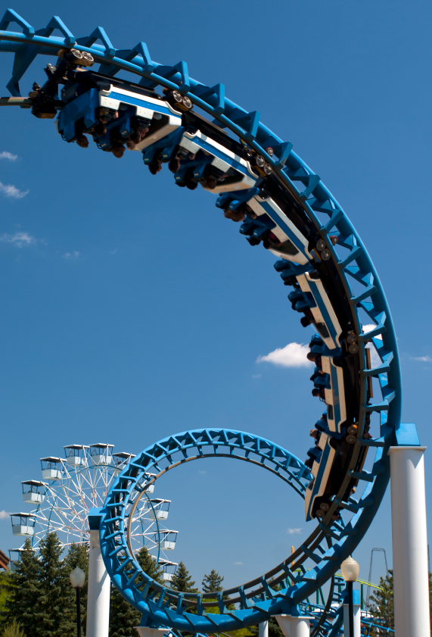
114 people went to the fair. 89 of them went in the evening. How many went during the day?

Slide 64
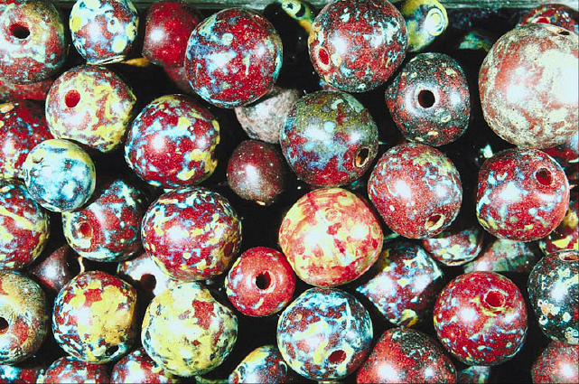
Chloe needs 153 beads to make a bag. She only has 49. How many more beads does she need?

Slide 65
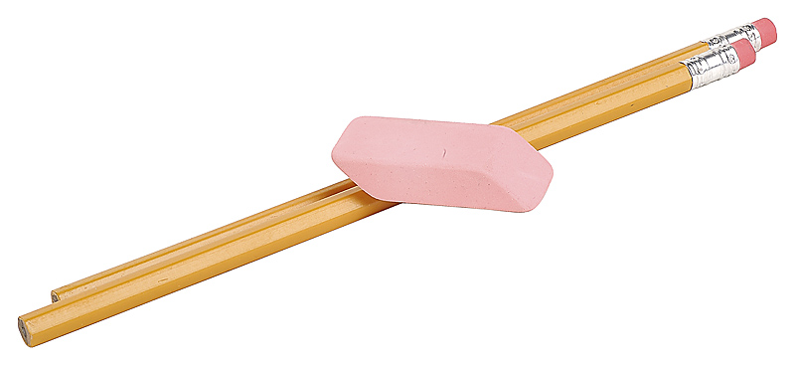
Mr. Ramos has 139 pencils and 88 erasers. How many more pencils than erasers does he have?

Slide 66
Jerry made 200 pizzas. He sold some of them and had 57 pizzas left. How many did he sell?

Slide 67
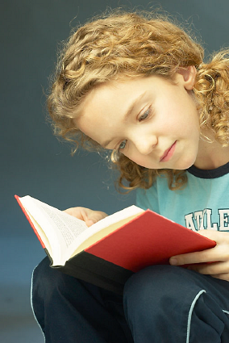
Kathy read 15 fewer pages than Lucy. Lucy read 51 pages. How many pages did Kathy read?

Slide 68
Eli spent 87 cents for a notebook and 38 cents for a pencil. How much money did he spend in all?
c

Slide 69
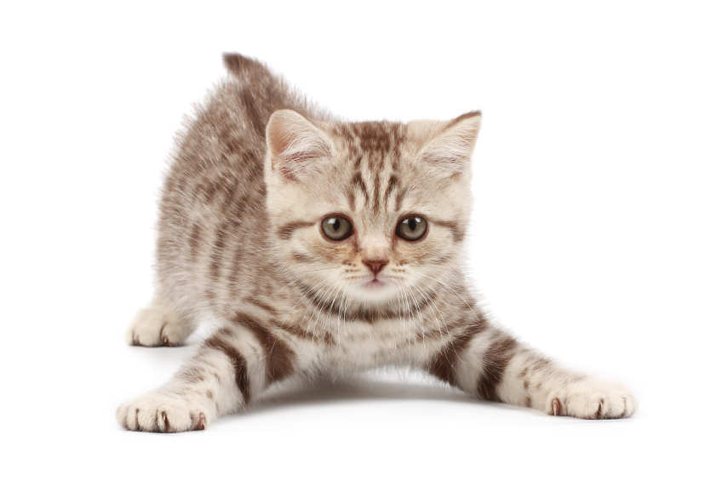
The shelter rescued 27 kittens in June. In July, it rescued 11 more. In August, it rescued 40 more. How many kittens did the shelter rescue during those 3 months? If 64 of those kittens found homes by August, how many still needed homes?

Slide 70
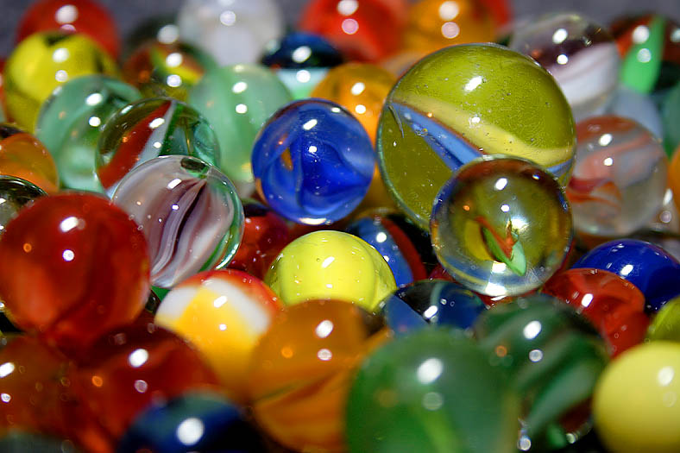
Max has 42 marbles in his marble bag after he added 20 marbles at noon. How many marbles did he have before noon?

Slide 71
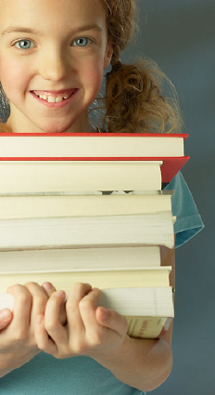
A children’s library sold 27 donated books. Now they have 48. How many books were there to begin with?

Slide 72
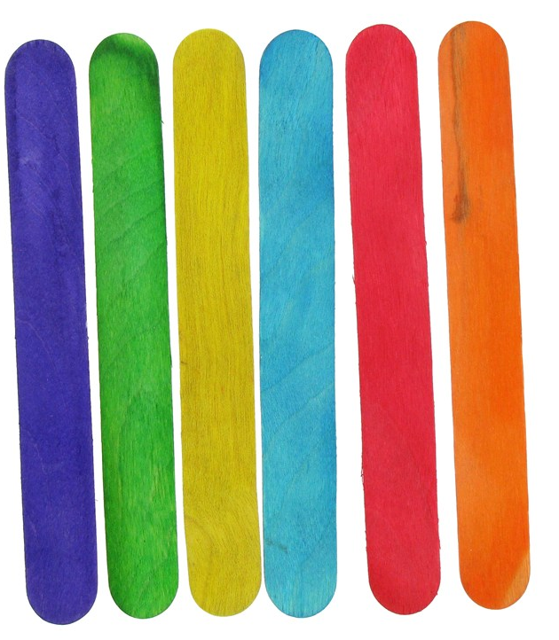
Diane needs 65 craft sticks to make a gift box. She only has 48. How many more craft sticks does she need?

Slide 73
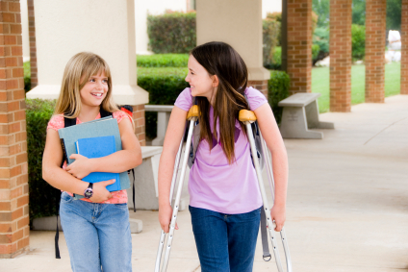
Jenny had 39 collectible cards in her collection. Tammy gave her 36 more. How many collectible cards does Jenny have now?

Slide 74
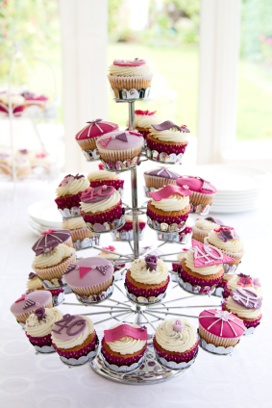
Maria made 60 cupcakes for the school bake sale. She sold 28 cupcakes on the first day. How many cupcakes did she have left?

Slide 75
Jeannie got a pedometer to count her steps. The first hour, she walked 43 steps. The next hour, she walked 48 steps.
  How many steps did she walk in the first two hours?
  How many more steps did she walk in the second hour than in the first?

Slide 76

Susan has 37 pennies. M.J. has 55 pennies more than Susan.
  How many pennies does M.J. have?
  How many pennies do they have altogether?

Slide 77
The table to the right represents the halftime score at a basketball game. The red team scored 19 points in the second half. The yellow team scored 13 points in the second half.
  Who won the game?
  By how much did that team win?
Red Team | 63 points
Yellow Team | 71 points

Slide 78

Benjie has 36 crayons. Ana has 12 fewer crayons than Benjie.
  How many crayons does Ana have?
  How many crayons do they have altogether?

Slide 79

Mr. Arnold has a box of pencils. He passes out 27 pencils and has 45 left. How many pencils did Mr. Arnold have in the beginning?

Slide 80
A fruit seller buys a carton of 90 apples. Finding that 18 of them are rotten, he throws them away. He sells 22 of the ones that are left on Monday. How many apples does he have left to sell?

Slide 81
Brienne has 23 fewer pennies than Alonzo. Alonzo has 45 pennies.
  How many pennies does Brienne have?
  How many pennies do Alonzo and Brienne have altogether?

Slide 82
Catriona earned 16 more stickers than Peter. She earned 35 stickers. How many stickers did Peter earn?
MaryJo earned 47 stickers. How many more does Peter need to have the same amount as MaryJo?

Slide 83

Will read 15 more pages than Marcy. Marcy read 38 pages. The book is 82 pages long.
  How many pages did Will read?
  How many more pages does Will need to read to finish the book?

Slide 84

Colleen put 27 fewer beads on her necklace than Jenny did. Colleen put on 46 beads. How many beads did Jenny put on her necklace? If 16 beads fell off of Jenny’s necklace, how many beads are still on it?

Slide 85
Joseph collected 49 golf balls from the course. He still had 38 fewer than his friend Ethan. How many balls did Ethan have? If Ethan gave Joseph 24 golf balls, who had more golf balls? How many more?

Slide 86
Julisa has 12 stuffed animals. She wants to put the same number of animals into each of 3 baskets. Draw a picture to show how she can put the animals into 3 equal groups. Then complete the sentence.
Julisa can put ___ animals into each basket.

Slide 87

Mayra sorts her socks by color. She has 4 purple socks, 4 yellow socks, 4 pink socks, and 4 orange socks. Draw groups to show how Mayra sorts her socks. Then write an addition sentence to match. How many socks does Mayra have in all?

Slide 88

Markers come in packs of 2. If Jessie has 6 packs of markers, how many markers does she have in all?
  Draw groups to show Jessie’s packs of markers.
  Write a repeated addition sentence to match your drawing.
  Group addends into pairs and add to find the total.

Slide 89

The flowers are blooming in Maria’s garden. There are 3 roses, 3 buttercups, 3 sunflowers, 3 daisies, and 3 tulips. How many flowers are there in all?
  Draw a tape diagram to match the problem.
  Write a repeated addition sentence to solve.

Slide 90
Mrs. White is in line at the bank. There are 4 teller windows, and 3 people are standing in line at each window.
                Draw an array to show the people in line at the bank.
                Write the total number of people.

Slide 91
Sam is organizing her greeting cards. She has 8 red cards and 8 blue cards. She puts the red ones in 2 columns and the blue ones in 2 columns to make an array.
  Draw a picture of Sam’s greeting cards in the array.
  Write a statement about Sam’s array.

Slide 92

Bobby puts 3 rows of tile in his kitchen to make a design. He lays 5 tiles in each row.
  Draw a picture of Bobby’s tiles.
  Write a number sentence to solve for the total number of tiles Bobby used.

Slide 93
Charlie has 16 blocks in his room. He wants to build equal towers with 5 blocks each.
  Draw a picture of Charlie’s towers.
  How many towers can Charlie make?
  How many more blocks does Charlie need to make equal towers of 5?
  Draw a picture of a different way Charlie could make equal towers using exactly 16 blocks.

Slide 94

Sandy’s toy telephone has buttons arranged in 3 columns and 4 rows.
  Draw a picture of Sandy’s telephone.
  Write a number sentence to show the total number of buttons on Sandy’s telephone.

Slide 95
Ty bakes two pans of brownies. In the first pan he cuts 2 rows of 8. In the second pan he cuts 4 rows of 4.
  Write a number sentence to show the total number of brownies in each pan.
  How many brownies did Ty bake altogether? Write a number sentence and a statement to show your answer.

Slide 96
Lulu made a pan of brownies. She cut them into 3 rows and 3 columns.
  Draw a picture of Lulu’s brownies in the pan.
  Write a number sentence to show how many brownies Lulu has.
  Write a statement about Lulu’s brownies.
Extension: How should Lulu cut her brownies if she wants to serve 12 people? 16 people? 20 people?

Slide 97
Ellie bakes a square pan of 9 lemon bars. Her brothers eat 1 row of her treats. Then her mom eats 1 column.
  Draw a picture of Ellie’s lemon bars before any are eaten. Write a number sentence to show how to find the total.
  Write an X on the bars that her brothers eat. Write a new number sentence to show how many are left.
  Draw a line through the bars that her mom eats. Write a new number sentence to show how many are left.
  How many bars are left? Write a statement

Slide 98
Rick is filling his muffin pan with batter. He fills 2 columns of 4. One column of 4 is empty. Draw to show the muffins and the empty column. Then write a repeated addition sentence to tell how many muffins Rick makes and how many muffin cups there are in the pan.

Slide 99
Rick is baking muffins again. He filled 3 columns of 3, and left one column of 3 empty. Color the pan to show what the muffin pan looked like. Write a repeated addition sentence to tell how many muffins he makes and how many muffin cups are in the whole pan.

Slide 100
Seven students sit on one side of a lunch table. Seven more students sit across from them on the other side of the table.
    Draw an array to show the students.
    Write an addition sentence that matches the array.
  Three more students sit down on each side of the table.
    Draw an array to show how many students there are now.
    Write an addition sentence that matches the new array.

Slide 101

Eggs come in cartons of 12. Use pictures, numbers, or words to explain whether 12 is even or not even.

Slide 102

Eggs come in cartons of 12. Joanna’s mom used 1 egg. Use pictures, numbers, or words to explain whether the amount left is even or odd.

Slide 103
Mrs. Boxer has 11 boys and 9 girls at a Grade 2 party.
  Write the number sentence to show the total number of people.
  Are the addends even or odd?
  Mrs. Boxer wants to pair everyone up for a game. Does she have the right number of people for everyone to have a partner?

Slide 104

There are 24 penguins sliding on the ice. There are 18 whales splashing in the ocean. How many more penguins than whales are there?

Slide 105

Gemma is counting animals in the park. She counts 16 robins, 19 ducks, and 17 squirrels. How many more robins and ducks did Gemma count than squirrels?

Slide 106

After a trip to the zoo, Ms. Anderson’s students
voted on their favorite animals. Use the bar graph
to answer the following questions.
  Which animal got the fewest votes?
  Which animal got the most votes?
  How many more students liked komodo dragons than koala bears?
  Later, two students changed their votes from koala bear to snow leopard. What was the difference between koala bears and snow leopards then?

Slide 107
Rita has 19 more pennies than Carlos. Rita has 27 pennies. How many pennies does Carlos have?

Slide 108

Sarah is saving money in her piggy bank. So far, she has 3 dimes, 1 quarter, and 8 pennies.
  How much money does Sarah have?
  How much more does she need to have a dollar?

Slide 109

Danny has 2 dimes, 1 quarter, 3 nickels, and 5 pennies.
  What is the total value of Danny’s coins?
  Show two different ways that Danny might add to find the total.

Slide 110

Kiko’s brother says that he will trade her 2 quarters, 4 dimes, and 2 nickels for a one dollar bill. Is this a fair trade? How do you know?

Slide 111

Clark has 3 ten dollar bills and 6 five dollar bills. He has 2 more ten dollar bills and 2 more five dollar bills than Shannon. How much money does Shannon have?

Slide 112

Andrew, Brett, and Jay all have 1 dollar in change in their pockets. They each have a different combination of coins. What coins might each boy have in his pocket?

Slide 113

Tracy has 85 cents in her change purse. She has 4 coins. Which coins are they?
How much more money will Tracy need if she wants to buy a bouncy ball for $1?

Slide 114
Richie has 24 cents. How much more money does he need to make $1?

Slide 115

Dante had some money in a jar. He puts 8 nickels into the jar. Now he has 100 cents. How much money was in the jar at first

Slide 116
Frances is moving the furniture in her bedroom. She wants to move the bookcase to the space between her bed and the wall, but she is not sure it will fit.
Talk with your partner: What could Frances use as a measurement tool if she doesn’t have a ruler? How could she use it?
Show your thinking on your personal board using pictures, numbers, or words.

Slide 117
Edwin and Tina have the same toy truck. Edwin says his is 4 toothpicks long. Tina says hers is 12 lima beans long. How can they both be right?
Work with a partner to measure your object. Partner A, measure with lima beans. Partner B, measure with toothpicks. Use words or pictures to explain how Edwin and Tina can both be right.

Slide 118
Benjamin measures his forearm and records the length as 15 inches. Then he measures his upper arm and realizes it’s the same!
  How long is one of Benjamin’s arms?
  What is the total length of both Benjamin’s arms together?

Slide 119
Ezra is measuring things in his bedroom. He thinks his bed is about 2 yards. Is this a reasonable estimate? Explain your answer using pictures, words or numbers.

Slide 120
Katia is hanging decorative lights. The strand of lights is 46 feet long. The building wall is 84 feet long. How many more feet of lights does Katia need to buy to equal the length of the wall?

Slide 121

In order to ride the Mega Mountain rollercoaster, riders must be at least 44 inches tall. Caroline is 57 inches tall. She is 18 inches taller than Addison. How tall is Addison? How many more inches must Addison grow to ride the rollercoaster?

Slide 122

Liza, Cecilia, and Dylan are playing soccer. Liza and Cecilia are 120 feet apart. Dylan is in between them. If Dylan is standing the same distance from both girls, how many feet is Dylan from Liza?

Slide 123
Mike, Dennis, and April all collected coins from a parking lot. When they counted up their coins, they found they had 24 pennies, 15 nickels, 7 dimes, and 2 quarters. They put all the pennies into one cup and the other coins in another. Which cup had more coins? How many more?

Slide 124
These are the types and numbers of stamps in Shannon’s stamp collection.
Her friend Michael gives her some flag stamps. If he gives her 7 fewer flag stamps than birthday and animal stamps together, how many flag stamps does she have?
If the flag stamps are worth 12 cents each, what is the total value of Shannon’s flag stamps?
Type of Stamp | Number of Stamps
Holiday | 16
Animal | 8
Birthday | 9
Famous Singers | 21

Slide 125

Judy bought an MP3 player and a set of earphones. The earphones cost $9, which is $48 less than the MP3 player. How much change should Judy get back if she gave the cashier a $100 bill?

Slide 126

Terrence is making shapes with 12 toothpicks. Draw 3 different shapes he could make using all of the toothpicks. How many other combinations can you find?

Slide 127
How many triangles can you find? (Hint: If you only found 10, keep looking!)

Slide 128
Three sides of a quadrilateral have the following lengths:
19 cm, 23 cm, and 26 cm. If the total distance around the shape is 86 cm, what is the length of the fourth side?

Slide 129

Owen had 90 straws to create pentagons. He created a set of 5 pentagons when he noticed a number pattern. How many more shapes can he add to the pattern?

Slide 130

Frank has 19 fewer cubes than Josie. Frank has 56 cubes. They want to use all of their cubes to build a tower. How many cubes will they use?

Slide 131

Mrs. Libarian’s students are picking up tangram pieces. They collect 13 parallelograms, 24 large triangles, 24 small triangles, and 13 medium triangles. The rest are squares. If they collect 97 pieces in all, how many squares are there?

Slide 132
The students were making larger shapes out of triangles and squares. They put away all 72 triangles. There were still 48 squares on the carpet. How many shapes were on the carpet when they started?

Slide 133
Mr. Thompson’s class raised 96 dollars for a field trip. They need to raise 120 dollars.
  How much more money do they need to raise in order to reach their goal?
  If they raise 86 more dollars, how much extra money will they have?

Slide 134

Felix is passing out raffle tickets. He passes out 98 tickets and has 57 left. How many raffle tickets did he have to start?

Slide 135

Jacob had collected 70 baseball cards. He gave half of them to his brother Sammy. How many baseball cards does Jacob have left?

Slide 136

Tugu made two pizzas for himself and his 5 friends. He wants everyone to have an equal share of the pizza. Should he cut the pizza into halves, thirds, or fourths?

Slide 137

Brownies take 45 minutes to bake. Pizza takes half an hour less than brownies to warm up. How long does pizza take to warm up?

Slide 138
At Memorial School, students have a quarter hour for morning recess and 33 minutes for a lunch break. How much free time do they have in all? How much more time for lunch than recess do they have?

Slide 139

On Saturdays, Jean may only watch cartoons for one hour. Her first cartoon lasts 14 minutes, and the second lasts 28 minutes. After a 5-minute break, Jean watches a 15-minute cartoon. How much time does Jean spend watching cartoons? Did she break her time limit?

