Slide 1
Claim 3 Smarter Balanced Sample Items Grade 3
Communicating Reasoning
Questions courtesy of the Smarter Balanced Assessment Consortium Item Specifications – Version 3.0
Slideshow organized by SMc Curriculum – www.ccssmathactivities.com

Slide 2
#1
Robert makes the following statement: “When comparing two fractions with a numerator of 1,
the fraction with the bigger denominator is greater.”
Drag each fraction to the correct location on the number line to find out if Robert’s statement is true.
$\frac{1}{2}$ $\frac{1}{4}$ $\frac{1}{8}$
Is Robert’s statement true? Click Yes or No.
Yes
No

Slide 3
#1 Answer
Rubric:
(2 points) The student places all three fractions in the correct locations and answers “No.”
(1 point) The student either places all the fractions in the correct locations and answers “Yes”; or places all fractions in the correct order but misses the correct location for one or more fractions and answers “No.”

Slide 4
#2
Marquis said, “The more numbers you multiply, the greater the product.” Then he wrote:
$$2×8=16$$
$$2×5×5=50$$
$$2×3×5×2=60$$
$$60>50>16$$
Give an example of a product of two numbers that is greater than $2×5×5$.
$$\left[ \right] ×\left[ \right]>\left(2×5×5\right)$$
Enter the numbers in the two response boxes.

Slide 5
#2 Answer
Rubric:
(1 point) The student enters two numbers in the response boxes whose product is greater than 50.
Answer: e.g., 7 and 8

Slide 6
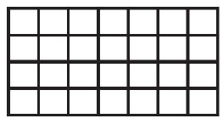
#3
Bev said, “I can find $5×6$ by adding $5×4$ and $5×2$.” She wrote this equation and drew this picture to show her thinking.
Mel wrote this equation: $4×7=4×3+4×4.$ Is this equation true? Click on Yes or No.
Click on the squares to draw a picture that supports your answer.

Slide 7
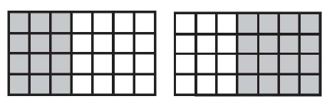
#3 Answer
Rubric:
(1 point) The student identifies the equation as true and clicks to shade either a $4×3$ rectangle or a $4×4$ rectangle
Answer: Examples:

Slide 8
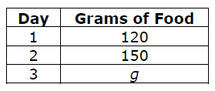
#4
A bird ate 400 grams of food in 3 days. The bird ate 120 grams of food on Day 1, 150 grams of food on Day 2, and g grams of food on Day 3.
How many grams of food did the bird eat on Day 3? Enter your answer in the first response box.
In the second response box, enter an equation that you could solve to find the amount of food the gird ate on Day 3.

Slide 9
#4 Answer
Rubric:
(2 points) The student enters the correct number of grams of food on Day 3 and enters a correct equation.
(1 point) The student enters the correct number of grams of food on Day 3 or enters a correct equation.
Answer: 130 grams; $400−120−150=x$, $120+150+x=400$ or equivalent equation

Slide 10
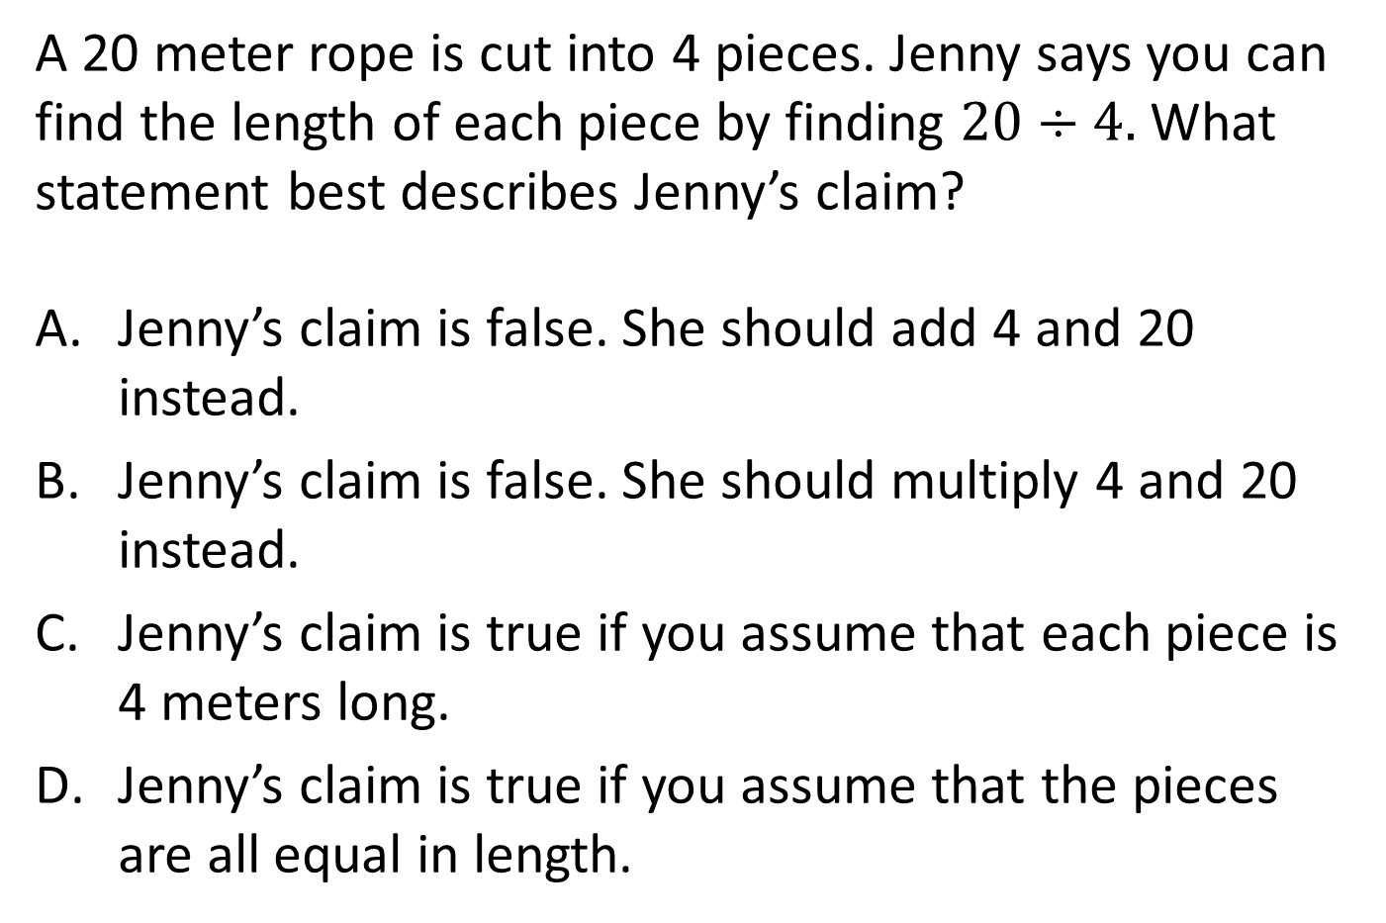
#5
A 20 meter rope is cut into 4 pieces. Jenny says you can find the length of each piece by finding $20÷4.$ What statement best describes Jenny’s claim?
Jenny’s claim is false. She should add 4 and 20 instead.
Jenny’s claim is false. She should multiply 4 and 20 instead.
Jenny’s claim is true if you assume that each piece is 4 meters long.
Jenny’s claim is true if you assume that the pieces are all equal in length.

Slide 11
#5 Answer
Rubric:
(1 point) The student selects the correct statement.
Answer: D

Slide 12
#6
Select all the ways you can divide 15 children into equal groups with none left over.
2 groups
3 groups
4 groups
5 groups

Slide 13
#6 Answer
Rubric:
(1 point) The student selects the possible number of groups.
Answer: B and D

Slide 14
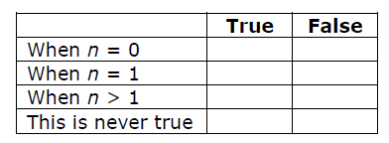
#7
$n$ is a whole number and $n×5=5$.
Identify which values of $n$ make this equation true.

Slide 15
#7 Answer
Rubric:
(1 point) The student identifies the correct values of $n$
Answer: F, T, F, F

Slide 16
#8
Tasha is solving this problem: There are 4 tanks with 10 fish in each tank. How many fish are there all together?
Tasha claims, “There are $4+10=14$ fish all together.”
Which statement best describes Tasha’s claim?
Tasha correctly added to find the total.
Tasha should subtract instead.
Tasha should multiply instead.
Tasha should divide instead.

Slide 17
#8 Answer
Rubric:
(1 point) The student selects the correct statement.
Answer: C

Slide 18
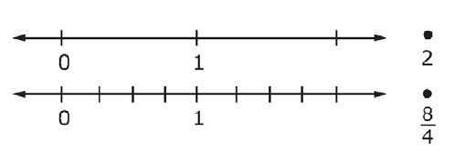
#9
Compare $\frac{8}{4}$ and $2$.
Part A
Plot each number on a number line.
Part B
$\frac{8}{4}$ $2$ Use $<, >, or=$to fill in the box

Slide 19
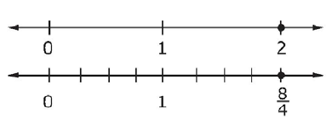
#9 Answer
Rubric:
(1 point) The student plots the points correctly and selects the correct comparison.
Answer: , and =

Slide 20
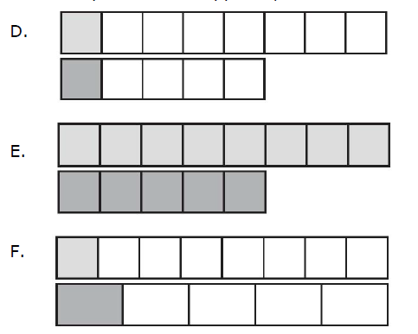

#10
Part A
Which comparison between $\frac{1}{5}$and $\frac{1}{8}$ is correct?
$\frac{1}{5}<\frac{1}{8}$
$\frac{1}{5}>\frac{1}{8}$
$\frac{1}{5}=\frac{1}{8}$
Part B
Choose a picture that supports your answer in Part A.

Slide 21
#10 Answer
Rubric:
(1 point) The student selects the correct comparison and the correct picture.
Answer: B, F

